Slide 1



Gobel Power
Success Stories & Testimonials
— Reliable Lithium Battery Solutions

Slide 2

Content Index
01
02
packs
cells

Slide 3
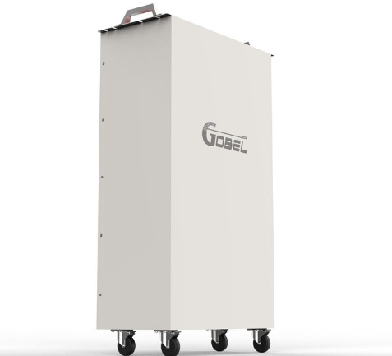
01 Success Stories & Testimonials of packs

Slide 4
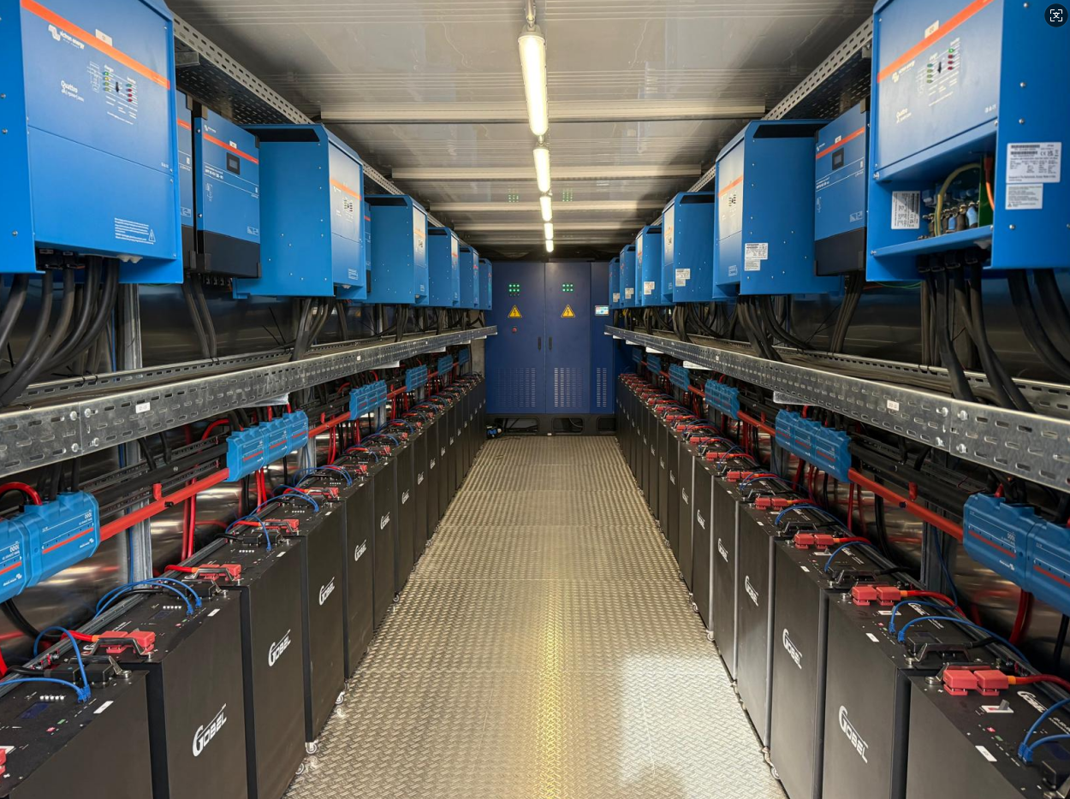

📍Country: German
🔋Capacity Type: 560kWh battery packs

Slide 5
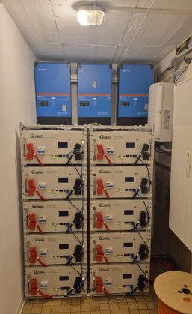

📍Country: German
🔋Capacity Type:
10 units of 16kWh home
Premium battery packs

Slide 6
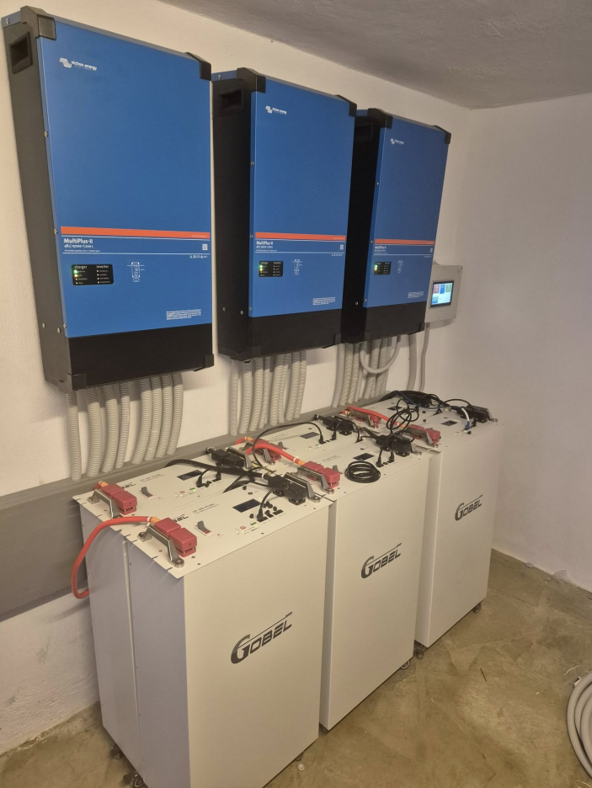
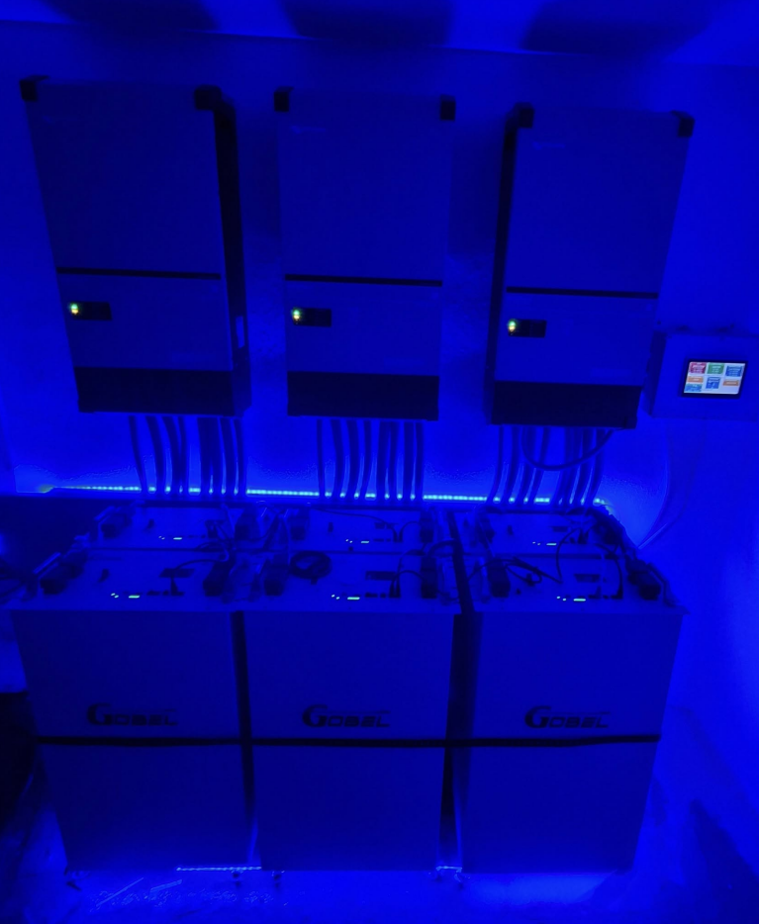
📍Country: German
🔋Capacity Type: 6 units of 15kWh battery packs

Slide 7
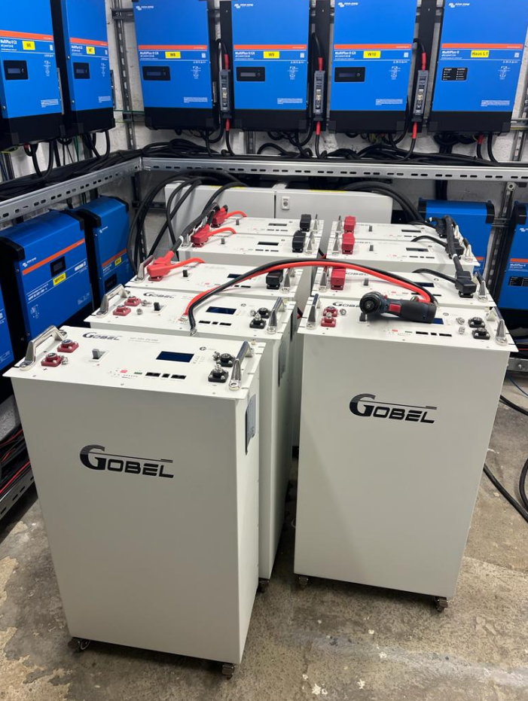
📍Country: German
🔋Capacity Type: 15kWh battery packs

Slide 8
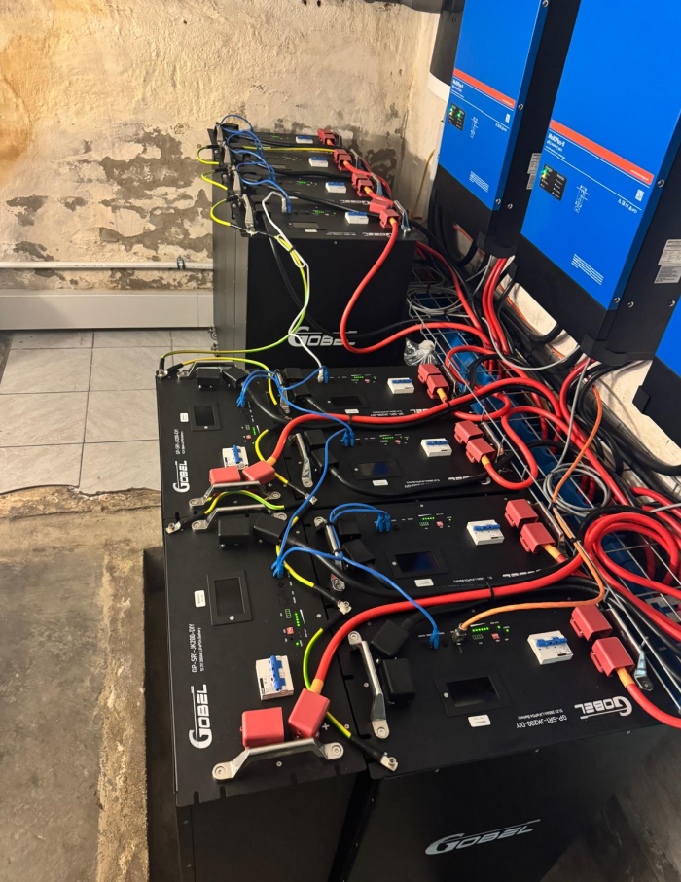
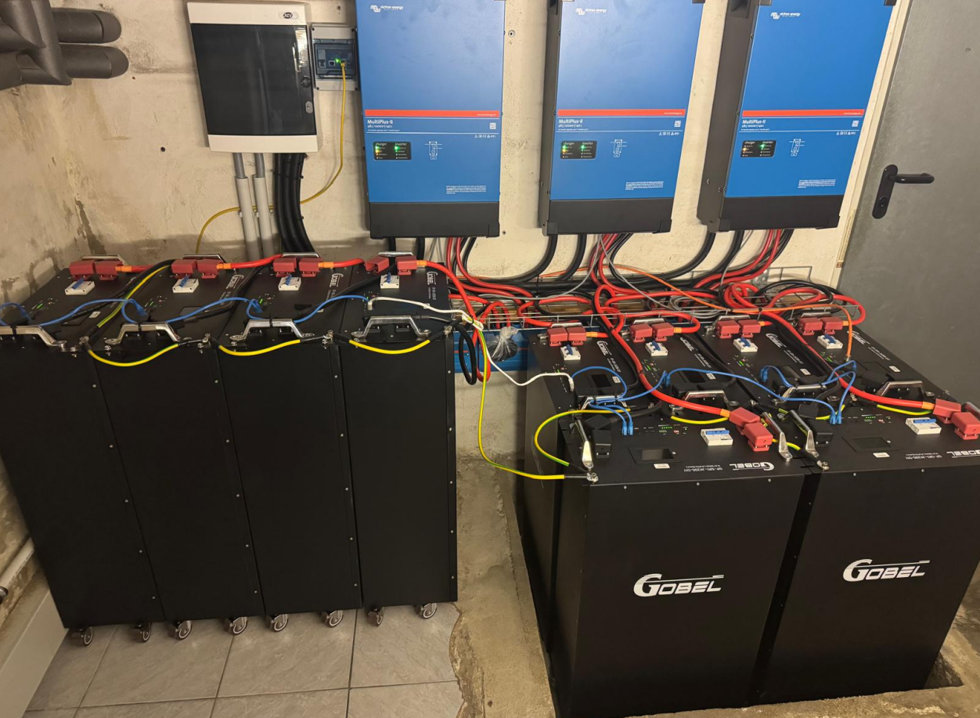
📍Country: German
🔋Capacity Type: 15kWh battery packs

Slide 9
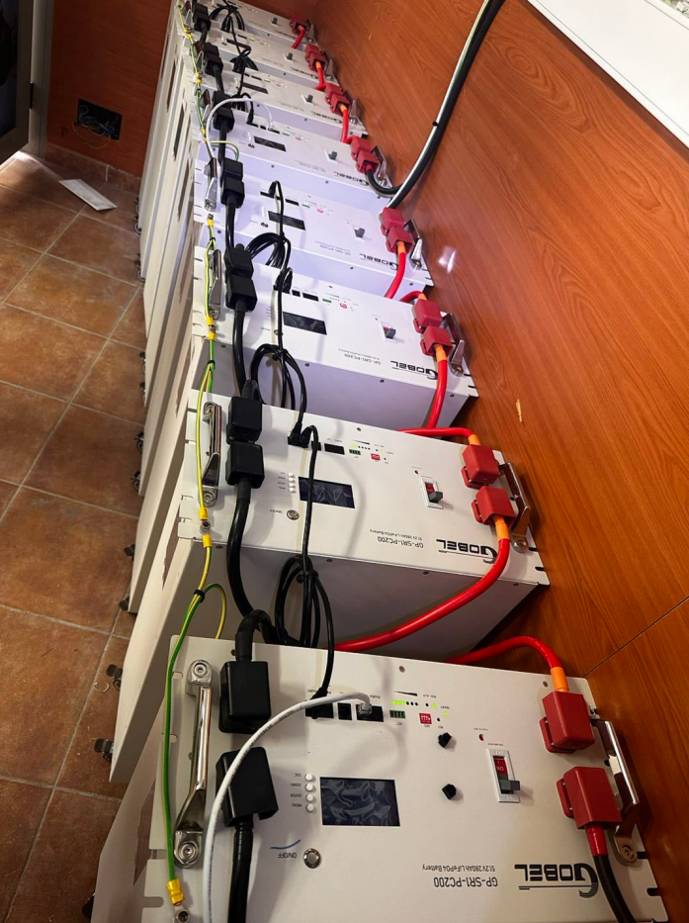
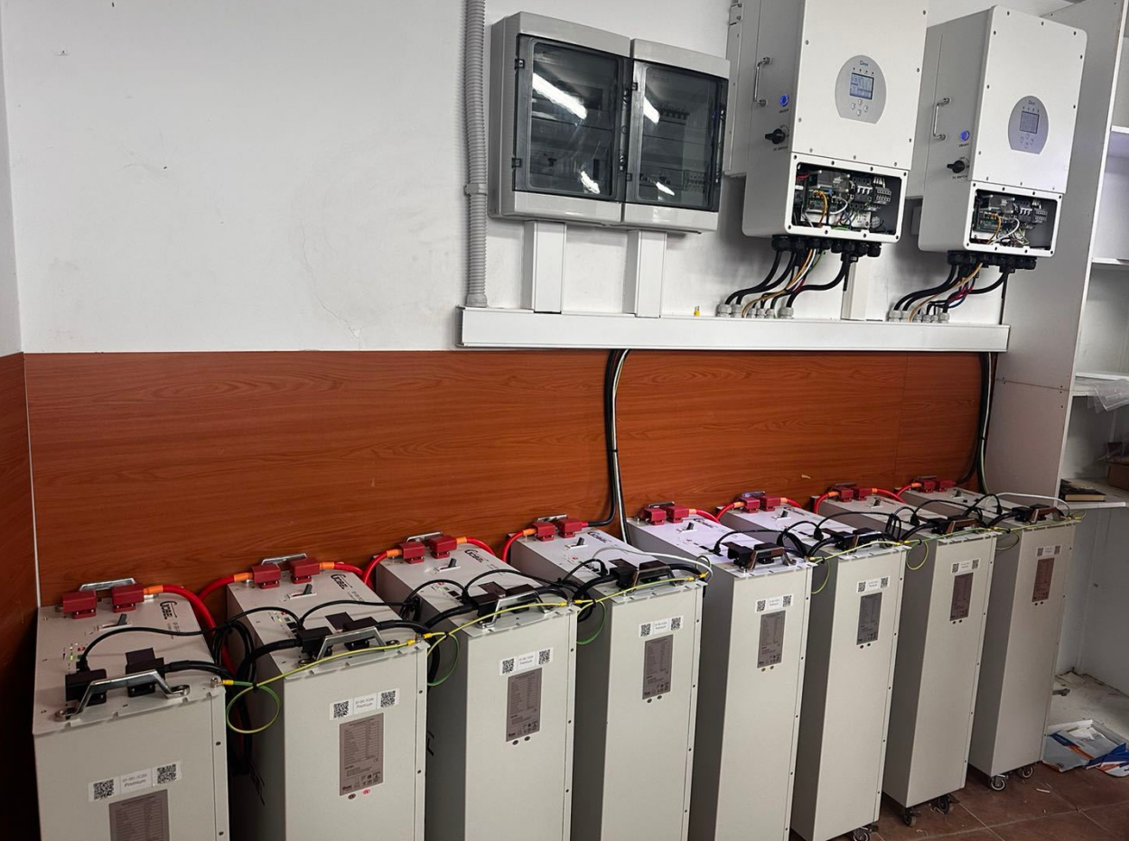
📍Country: German
🔋Capacity Type: 15kWh battery packs

Slide 10
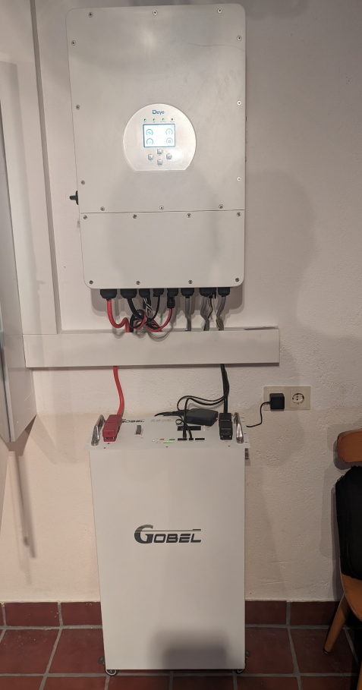
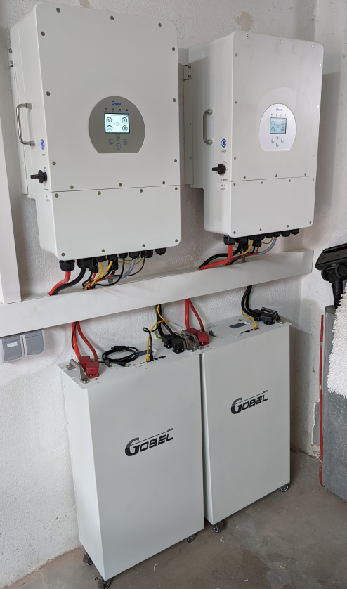
📍Country: German
🔋Capacity Type: 15kWh battery packs

Slide 11
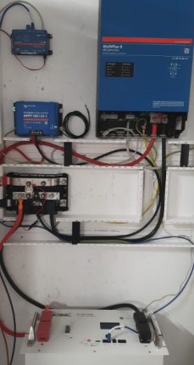
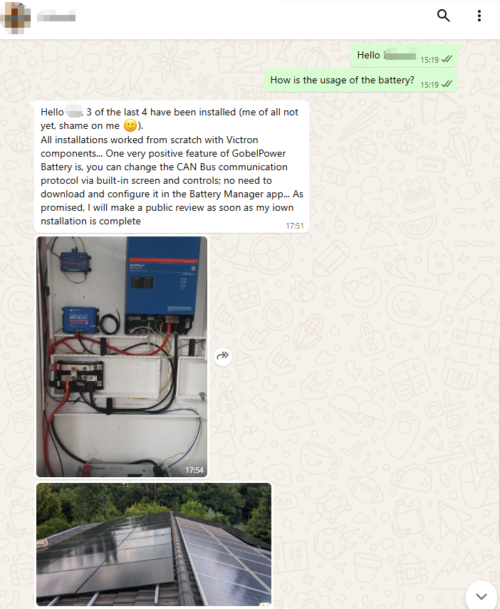
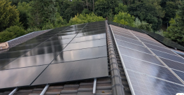
📍Country: German
🔋Capacity Type: 4 units of 15kWh battery packs

Slide 12
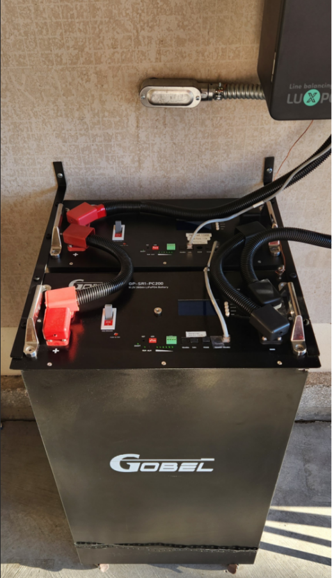
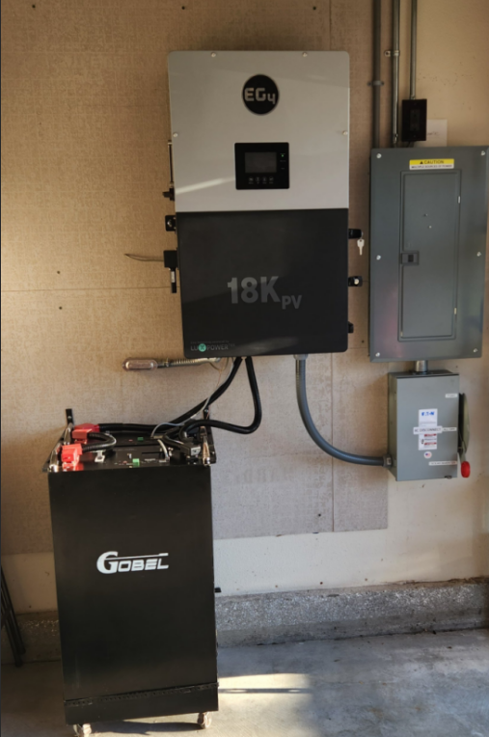
📍Country: German
🔋Capacity Type: 2 units of 15kWh battery packs

Slide 13
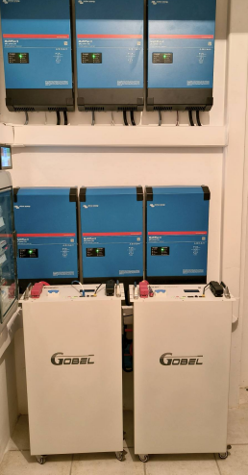
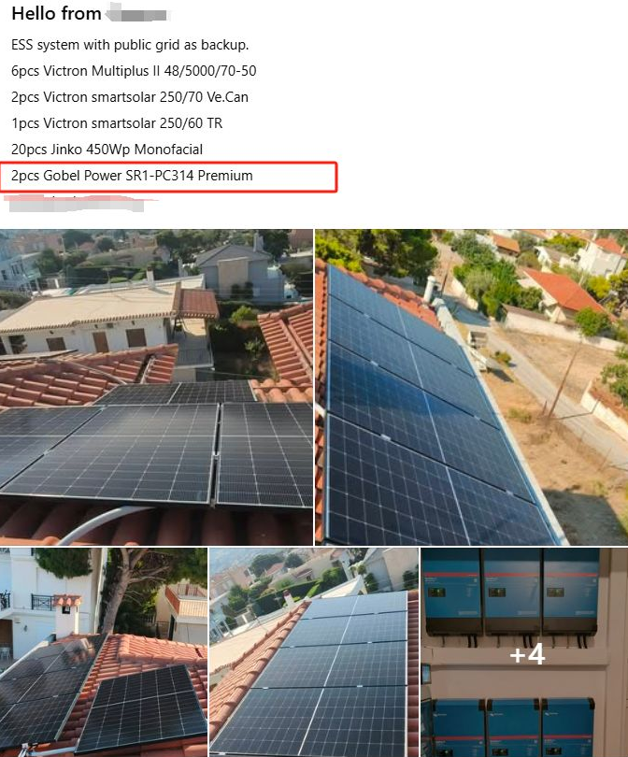
📍Country: Greece
🔋Capacity Type: 2 units of 16kWh battery packs

Slide 14
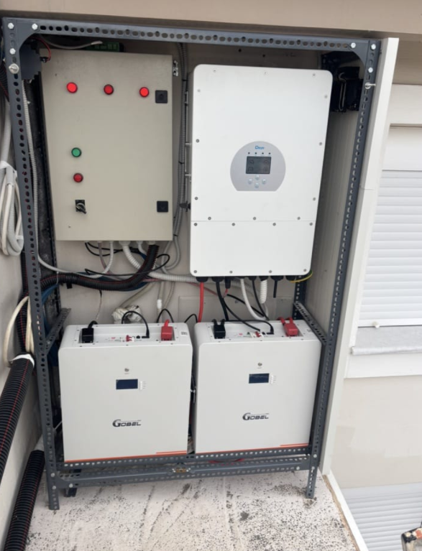
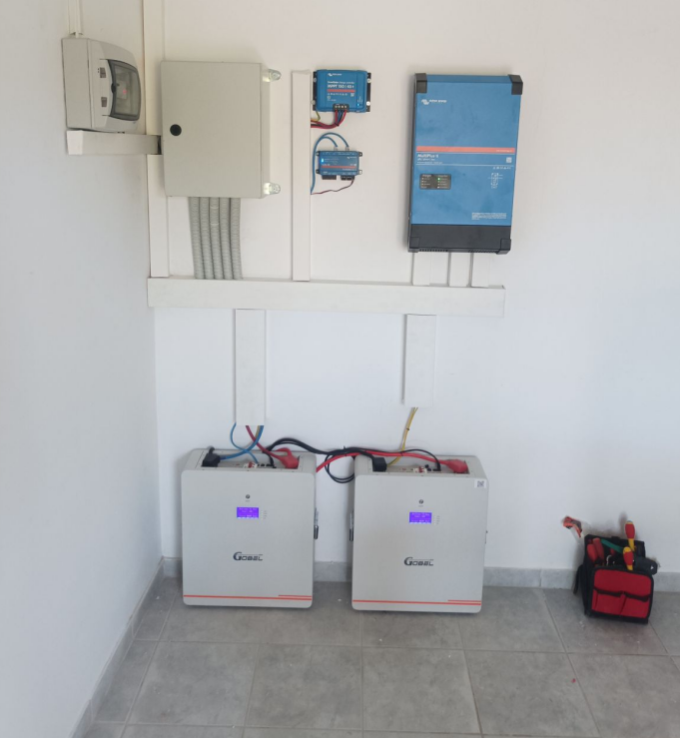
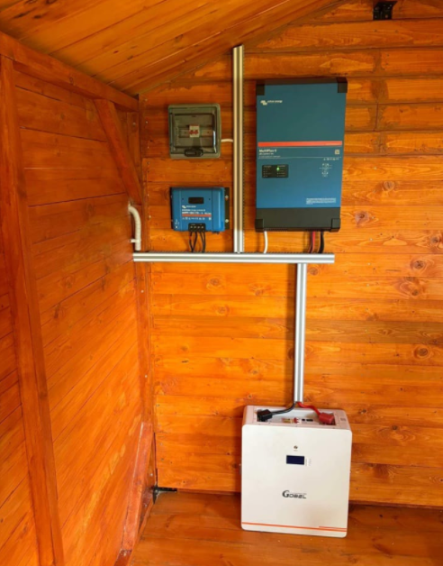
📍Country: Greece
🔋Capacity Type: 10kWh battery packs

Slide 15
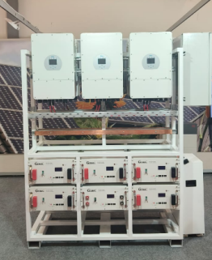
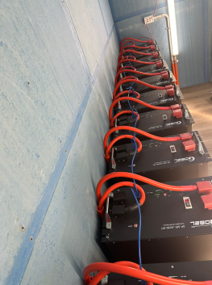
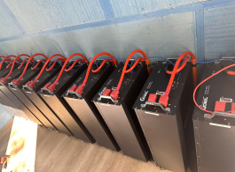
📍Country: Greece
🔋Capacity Type: 15kWh battery packs

Slide 16
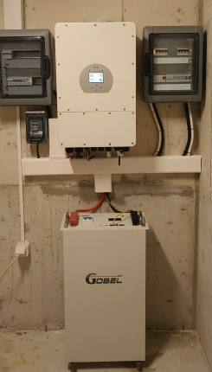
📍Country: Greece
🔋Capacity Type:
16kWh battery packs

Slide 17
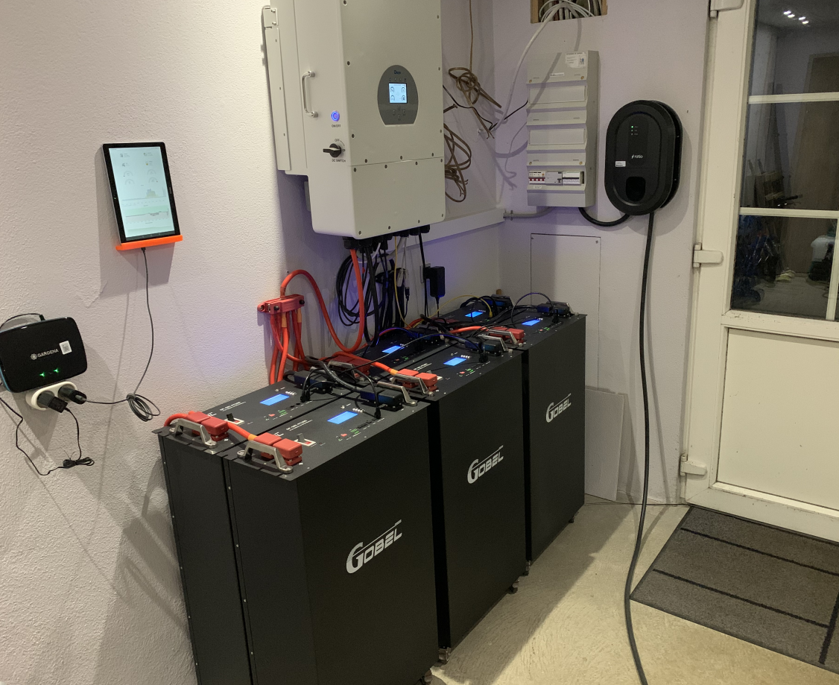
📍Country: Austria
🔋Capacity Type: 6 units 15kWh battery packs

Slide 18
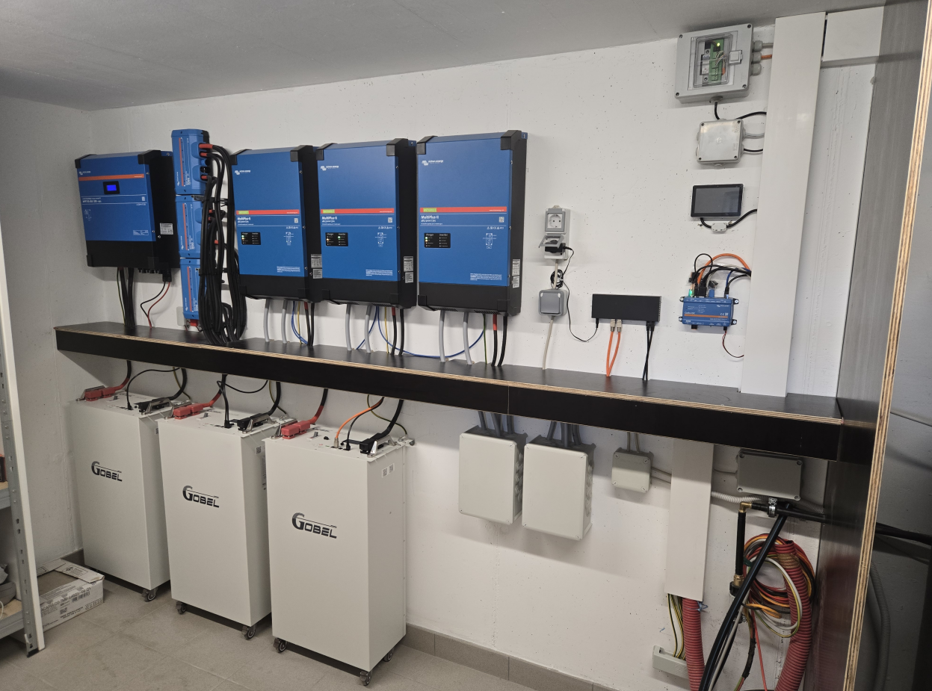
📍Country: Austria
🔋Capacity Type: 3 units 15kWh battery packs

Slide 19
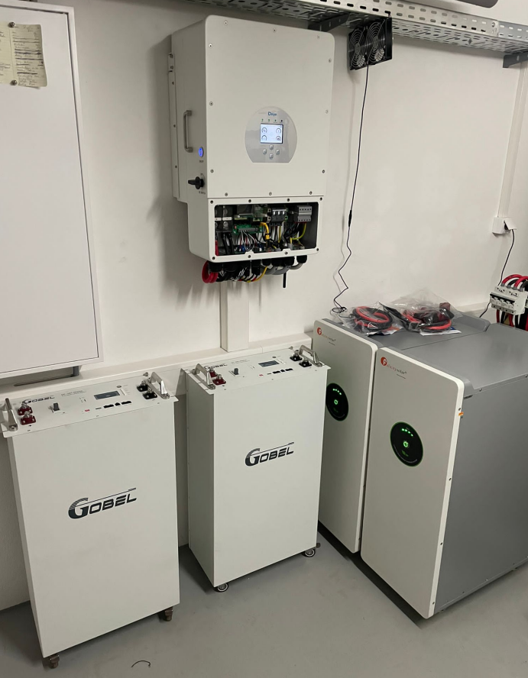
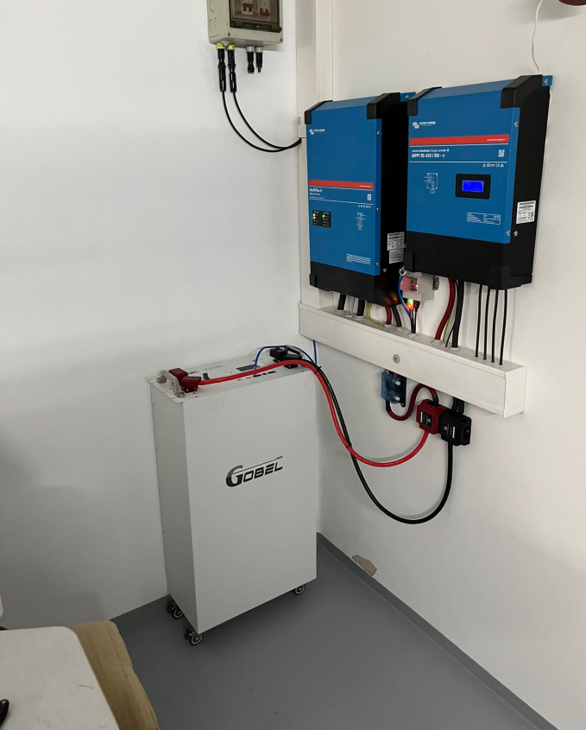
📍Country: Austria
🔋Capacity Type: 15kWh battery packs

Slide 20
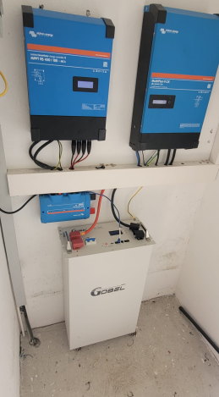
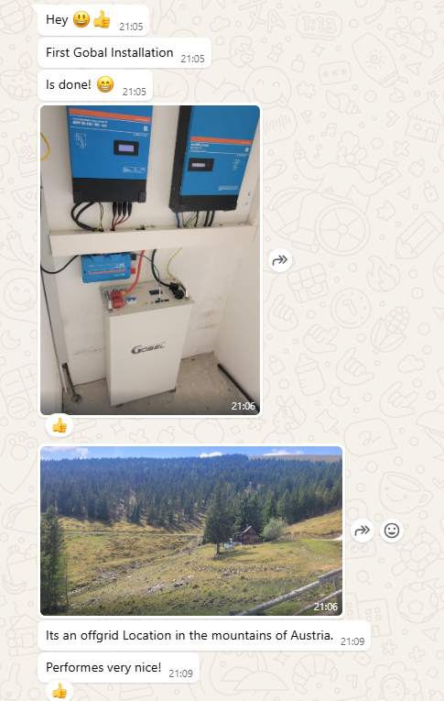
📍Country: Austria
🔋Capacity Type: 15kWh battery packs

Slide 21
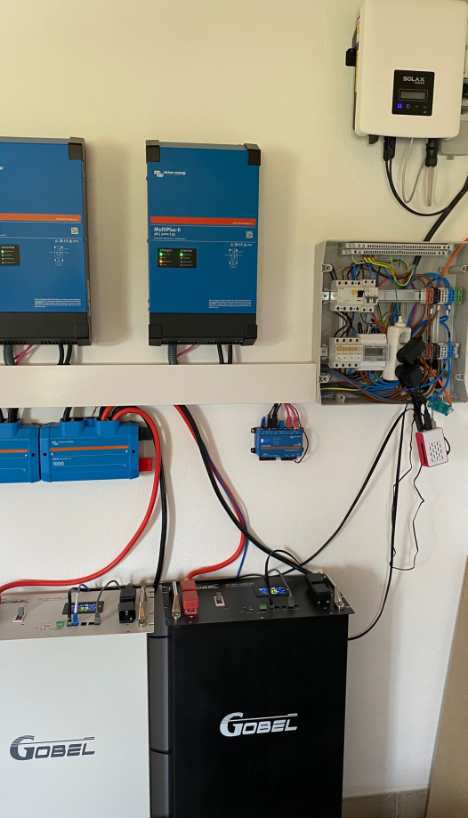
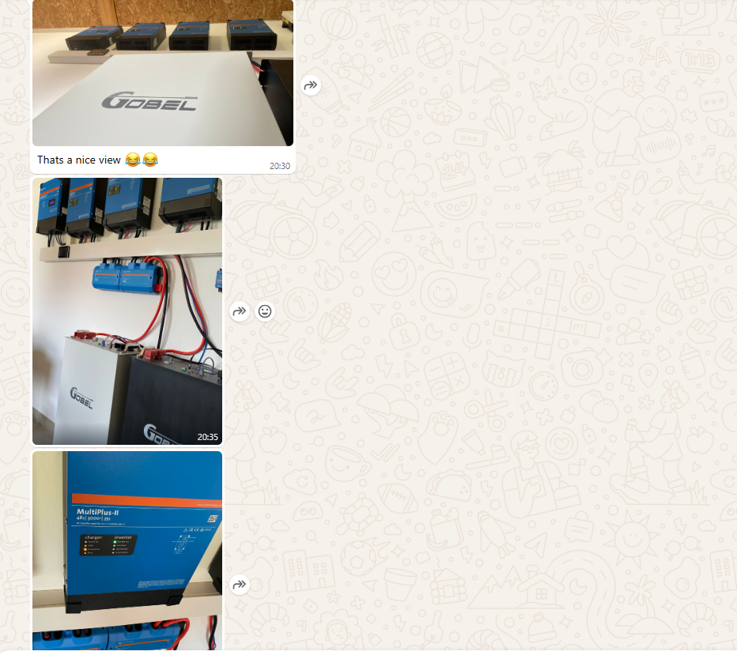
📍Country: Austria
🔋Capacity Type: 2 units 15kWh battery packs

Slide 22
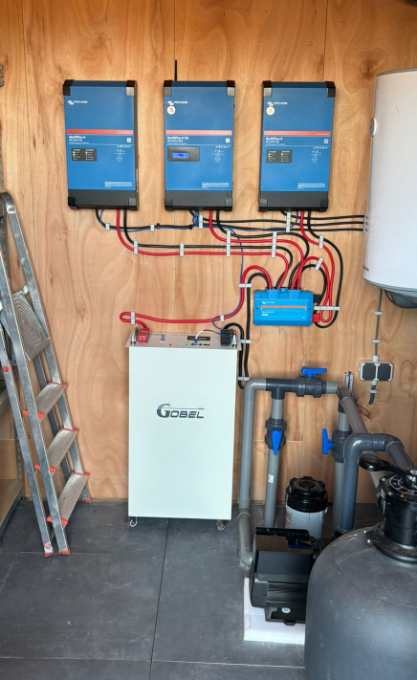
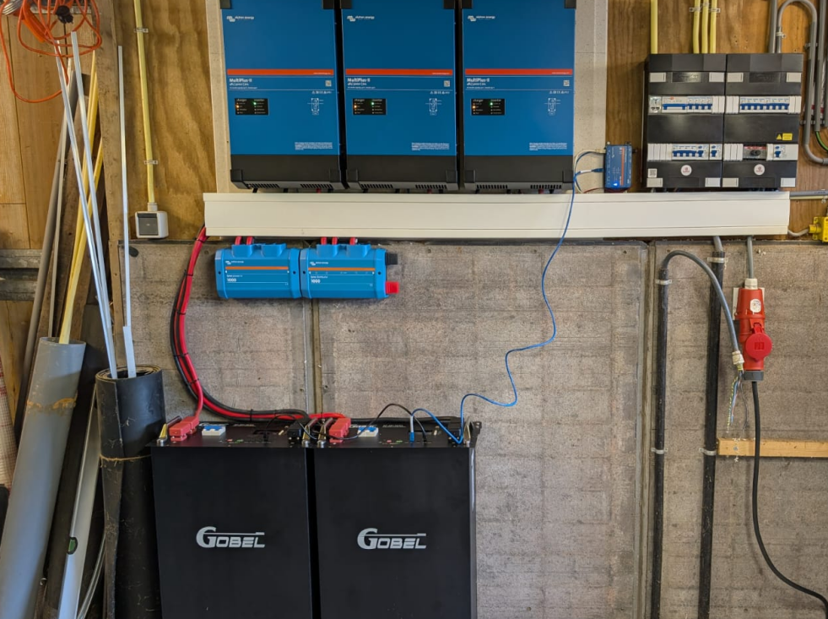
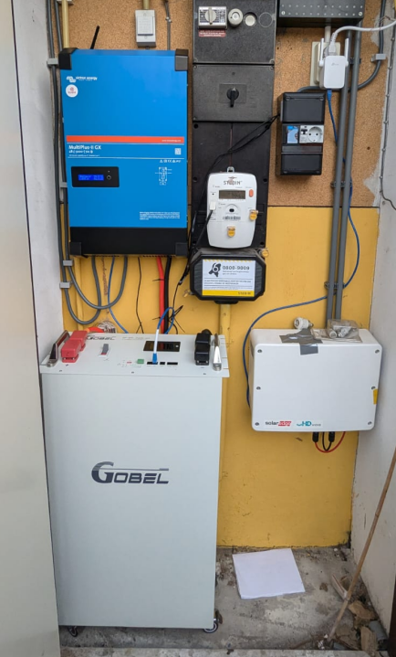
📍Country: Netherlands
🔋Capacity Type: 4 units of 15kWh battery packs

Slide 23
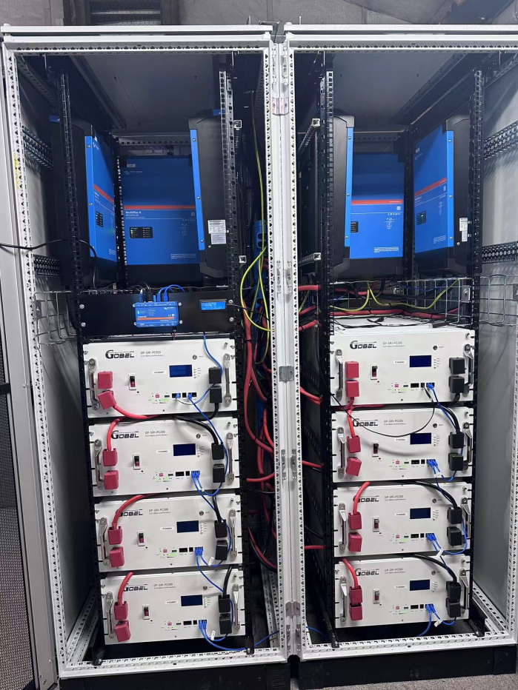
📍Country: Netherlands
🔋Capacity Type:
8 units 15kWh battery packs

Slide 24
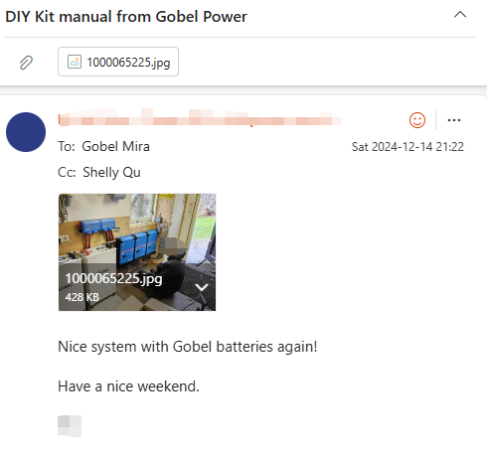
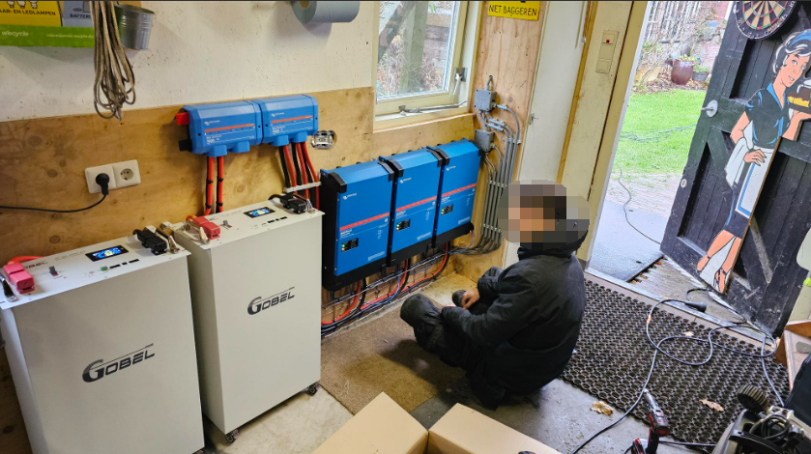
📍Country: Netherlands
🔋Capacity Type: 2 units of 15kWh battery packs

Slide 25
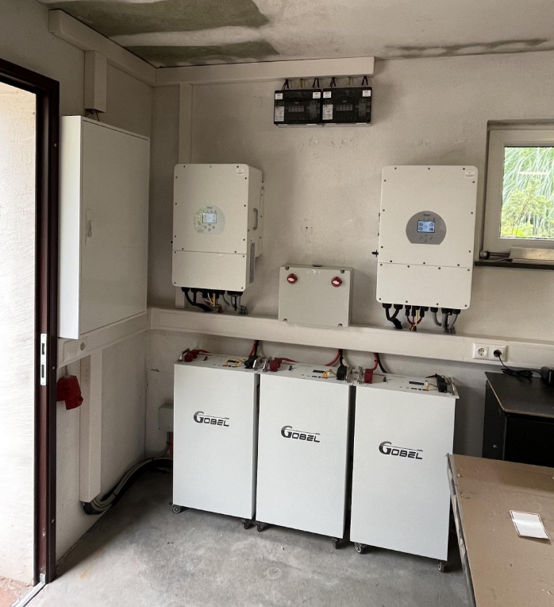
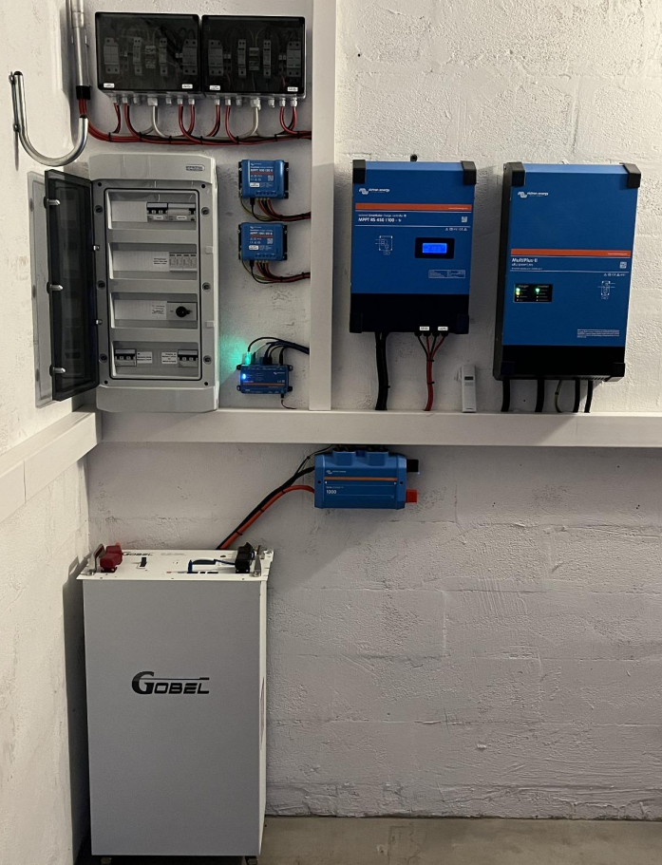
📍Country: Australia
🔋Capacity Type: 15kWh battery packs

Slide 26
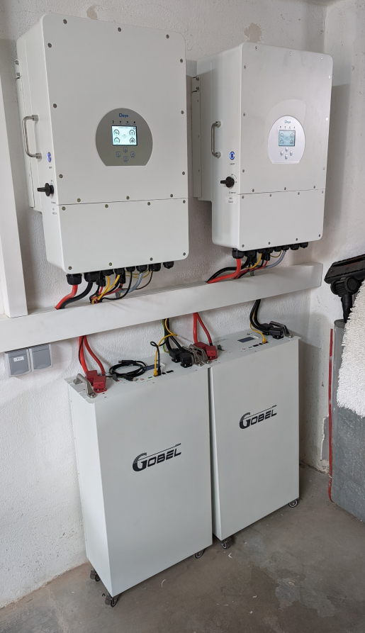
📍Country: Australia
🔋Capacity Type:
15kWh battery packs

Slide 27
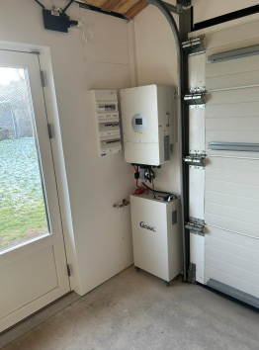
📍Country: Denmark
🔋Capacity Type:
1 unit of 15 kWh battery packs

Slide 28
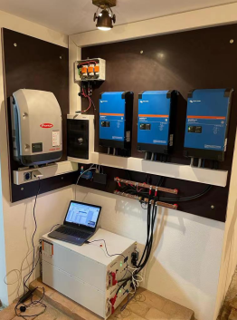
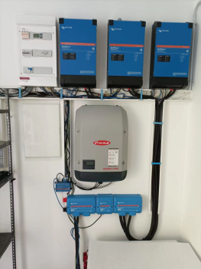
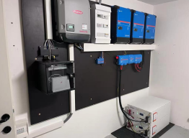
📍Country: Hungary
🔋Type: Victron System shared by a customer

Slide 29
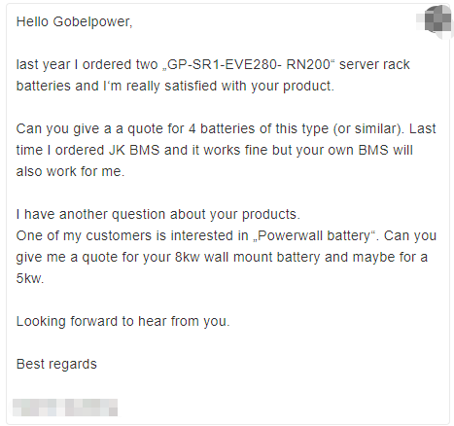
✨ Customer Feedback:
I'm really satisfied with your product

Slide 30
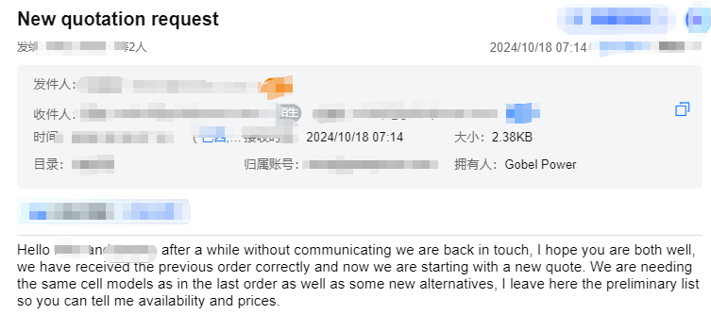
✨ Customer Feedback:
Repeat purchase by Argentine customers

Slide 31
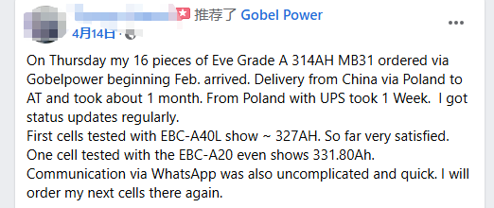
✨ Facebook Customer Feedback:
First cells tested with EBC-A40L show ~ 327AH.
So far very satisfied.One cell tested with the
EBC-A20 even shows 331.80Ah.

Slide 32

✨ German Customer Feedback:
Yes, testing is already done with perfect results !

Slide 33

✨ Customer Feedback:
Everything looks good !
📍Country: Greece

Slide 34

✨ Customer Feedback:
You have the best products on
the market and care about customers.

Slide 35

✨ German Customer Feedback:
Gobel is a great ompanylwil definitely recommend you to
others and willprobably order a second batery from you this vear.

Slide 36

📍 Country: Holand
✨ Customer Feedback:
They work very well together！

Slide 37

📍 Country: Australia
✨ Customer Feedback:
His installer was veryimpressed
about your batteries

Slide 38

✨ Customer Feedback:
FYl i stopped selling XXX
and focus on Gobelpower
from now on!

Slide 39

✨ Customer Feedback:
l recommend Gobel Power to anyone who might be scared of
the complex Chinese market.

Slide 40

02 Success Stories & Testimonials of cells

Slide 41


🔋German Customer - Battery System
Hithium 280Ah cells battery

Slide 42


🔋 German Customer - Battery System
Cells supplied by Gobel Power

Slide 43

🔋 German Customer - Battery System
Cells supplied by Gobel Power

Slide 44


📍Country: German
🔋Capacity : 16 units of cells battery

Slide 45

🔋 German Customer :
Battery System
Cells supplied by Gobel Power

Slide 46


📍Country: German
🔋The cells from Gobel Power
📍Country: France
🔋The cells from Gobel Power

Slide 47



📍Country: Austria
📍Country: German
📍Country: Belgium

Slide 48


📍Country: Slovakia
🔋The cells fome Gobel Power
📍Country: Ukraine
🔋The cells fome Gobel Power

Slide 49


📍Country: Finland
🔋The cells battery from Gobel Power

Slide 50


📍Country: Romania
🔋The EVE 314ah cells battery from Gobel Power

Slide 51

✨ German customer Feedback:
You and especially thecompany Gobel make the best
impress to me.

Slide 52

✨ German customer Feedback:
Everything is excellent, and I highly recommend these batteries.

Slide 53

and took about 6 weeks to get to Melbourne
✨ Australia customer Feedback:
Batteries were well packaged and took about 6 weeks to
get to Melbourne.

Slide 54

✨ German customer Feedback:
Batteries arrivede yesterday and theyare in best Conditions.

Slide 55

✨ German customer Feedback:
Goods arrived today, looks perfect. Can lorder more ?

Slide 56

✨ German customer Feedback:
The voltage of all the 16 cells are checked with a result o3.288 to 3.293. The max difference is 0.005v, which are very good.

Slide 57

✨ German customer Feedback:
I'll definitely order from there again
—the prices are excellent.

Slide 58

✨ German customer Feedback:
Testing results was good!

Slide 59

✨ German customer Feedback:
But only heard good things aboutGobel Power

Slide 60

✨ German customer Feedback:
I'm also making videos on YouTube to promote Gobel Power.

Slide 61

✨ German customer Feedback:
And yes, last delivery was perfect, came on time, in pretty
good quality.

Slide 62

✨ South Africa customer Feedback:
The cells are in pristine condition. The packaging
was EXCELLENT with each cell in .

Slide 63

✨ Argentina customer Feedback:
I think we would be in a position to make this purchase
with you .

Slide 64

✨ Hungary customer Feedback:
So all in all l am very happy with
the deal and will return for more.

Slide 65

✨ Austria customer Feedback:
Compared to other merchants, Super Good.

Slide 66

✨ Netherlands customer Feedback:
Yes all looks good, thank you !

Slide 67

✨ Customer Feedback:
Give you a good review as
supplier who is honest and
hasintegrity and trustworthy

Slide 68



Thank
You！
cs@gobelpower.com
https://www.gobelpower.com/
+86-134 8066 9029

