Slide 1



Gobel Power
Success Stories & Testimonials
— Reliable Lithium Battery Solutions

Slide 2

Content Index
01
cells

Slide 3
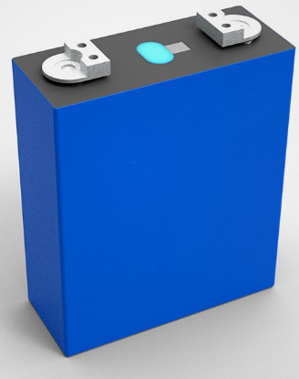

01 Success Stories & Testimonials of cells

Slide 4
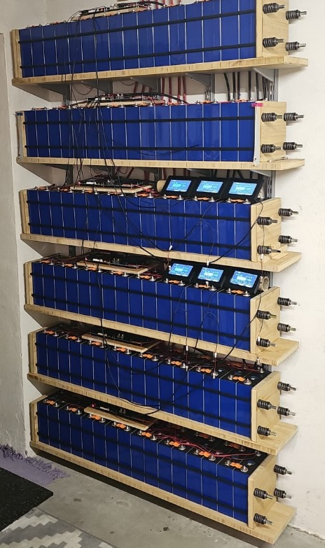
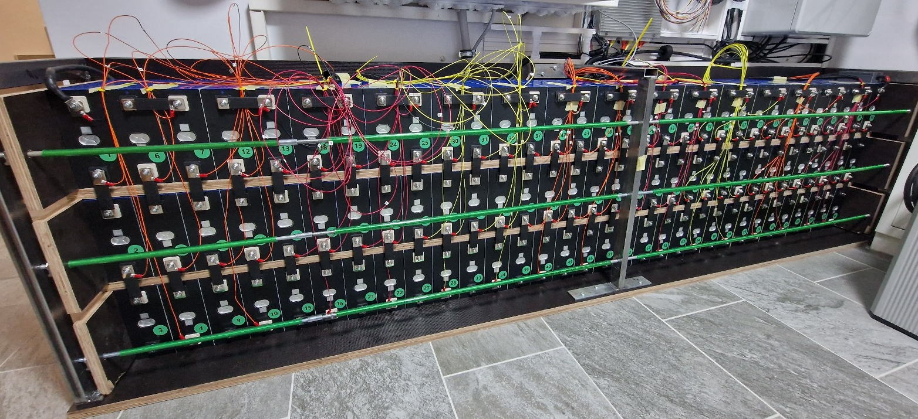
🔋German Customer - Battery System
Hithium 280Ah cells battery

Slide 5
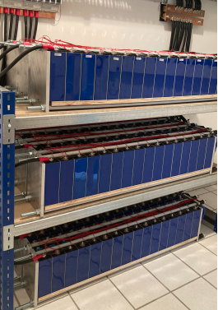
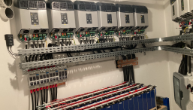
🔋 German Customer - Battery System
Cells supplied by Gobel Power

Slide 6
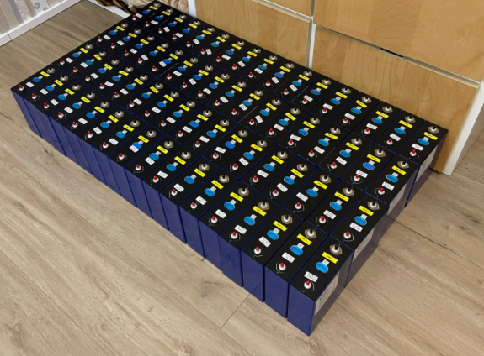
🔋 German Customer - Battery System
Cells supplied by Gobel Power

Slide 7
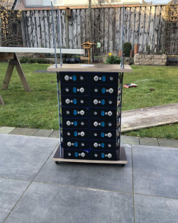
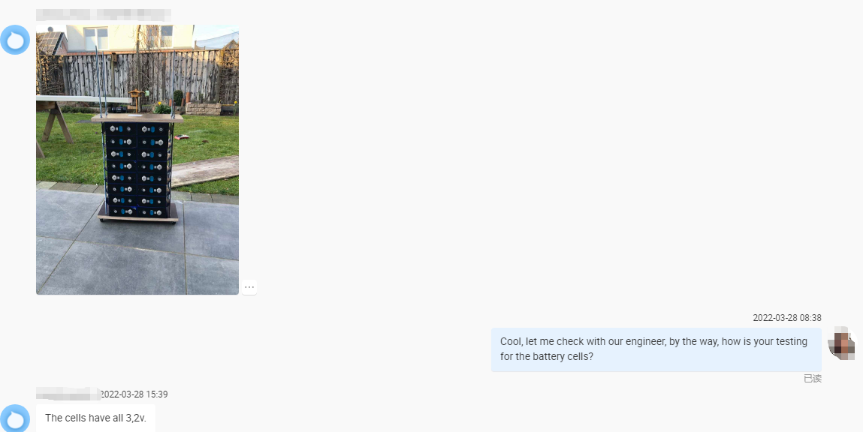
📍Country: German
🔋Capacity : 16 units of cells battery

Slide 8
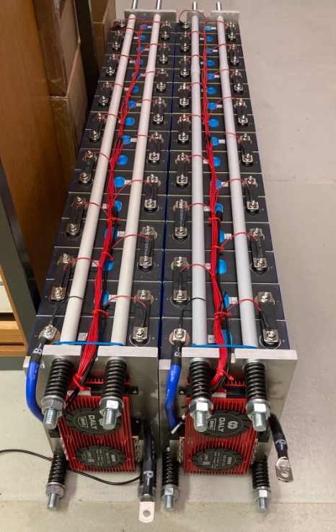
🔋 German Customer :
Battery System
Cells supplied by Gobel Power

Slide 9
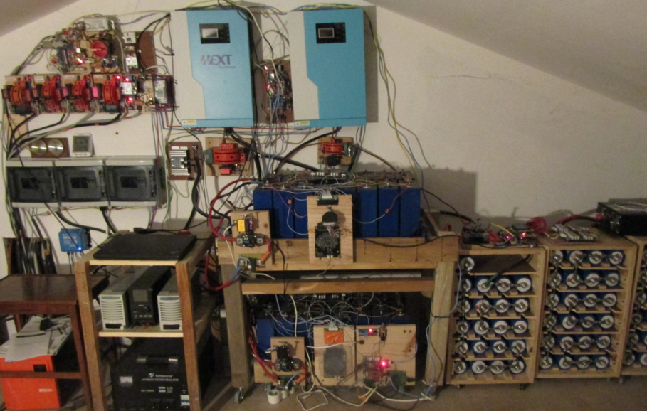
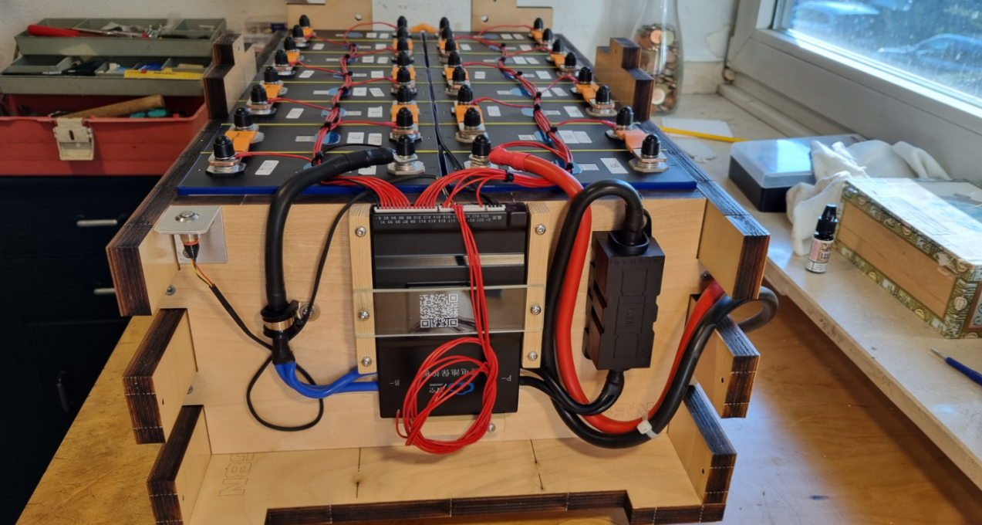
📍Country: German
🔋The cells from Gobel Power
📍Country: France
🔋The cells from Gobel Power

Slide 10
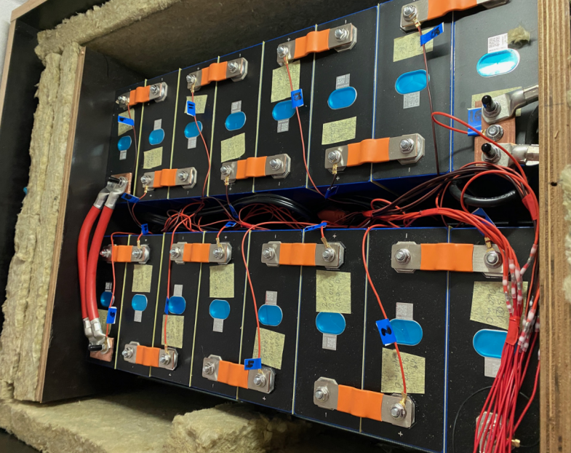
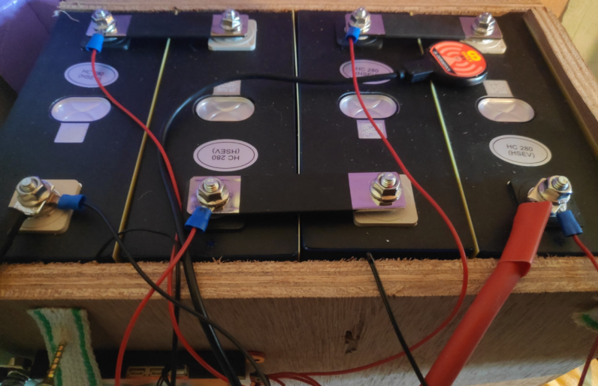
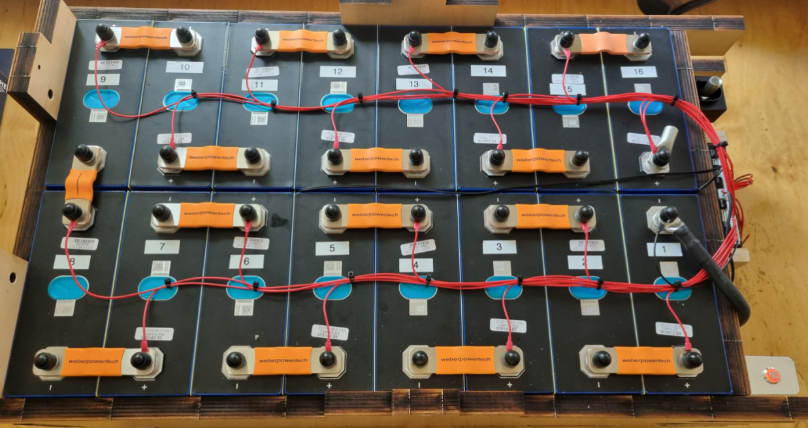
📍Country: Austria
📍Country: German
📍Country: Belgium

Slide 11
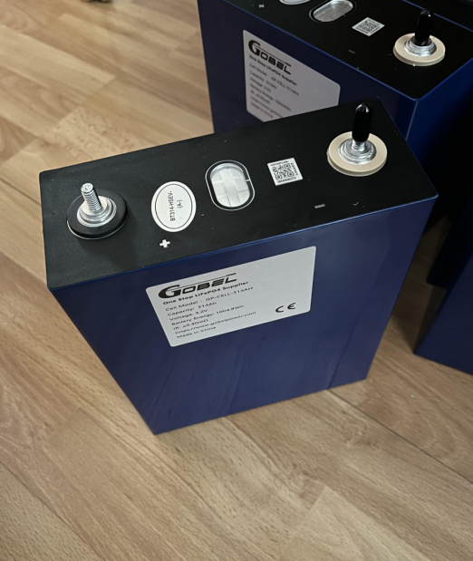
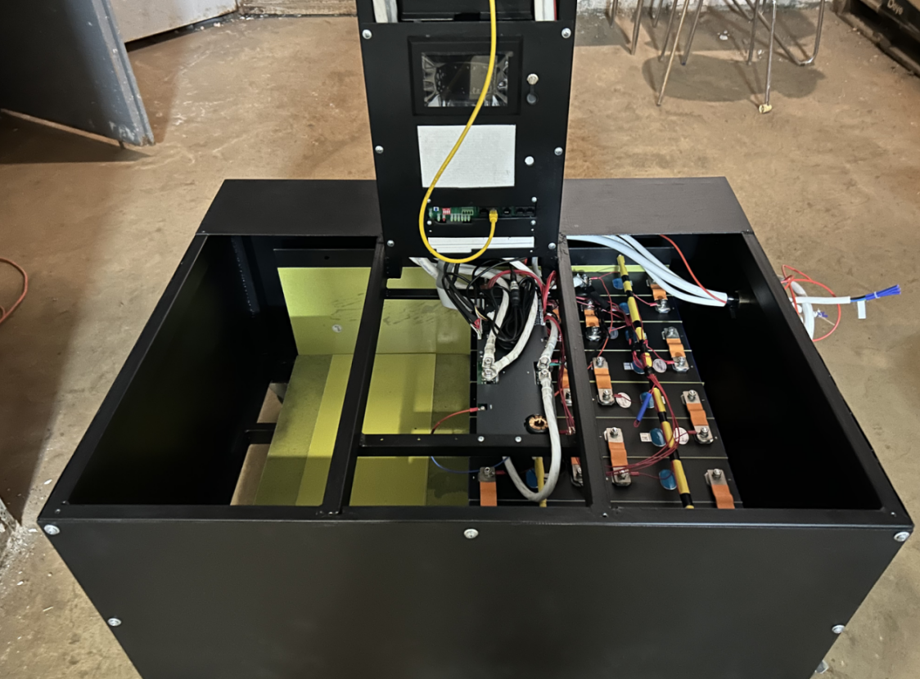
📍Country: Slovakia
🔋The cells fome Gobel Power
📍Country: Ukraine
🔋The cells fome Gobel Power

Slide 12
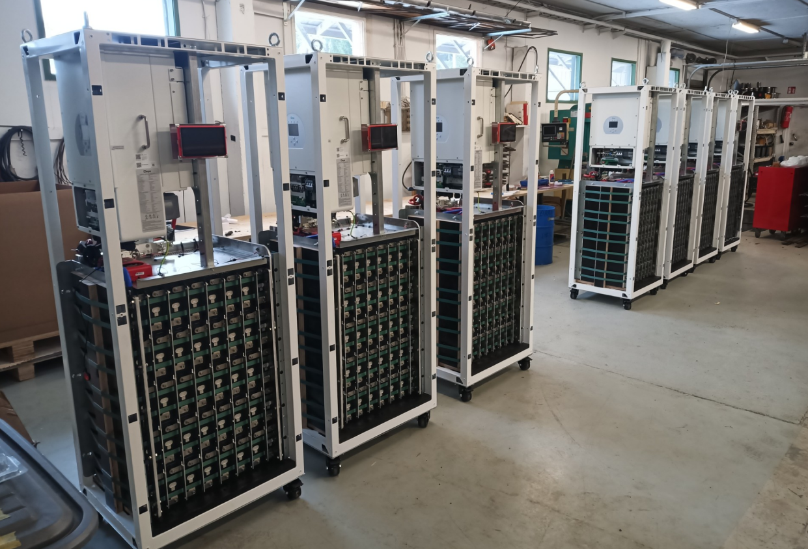
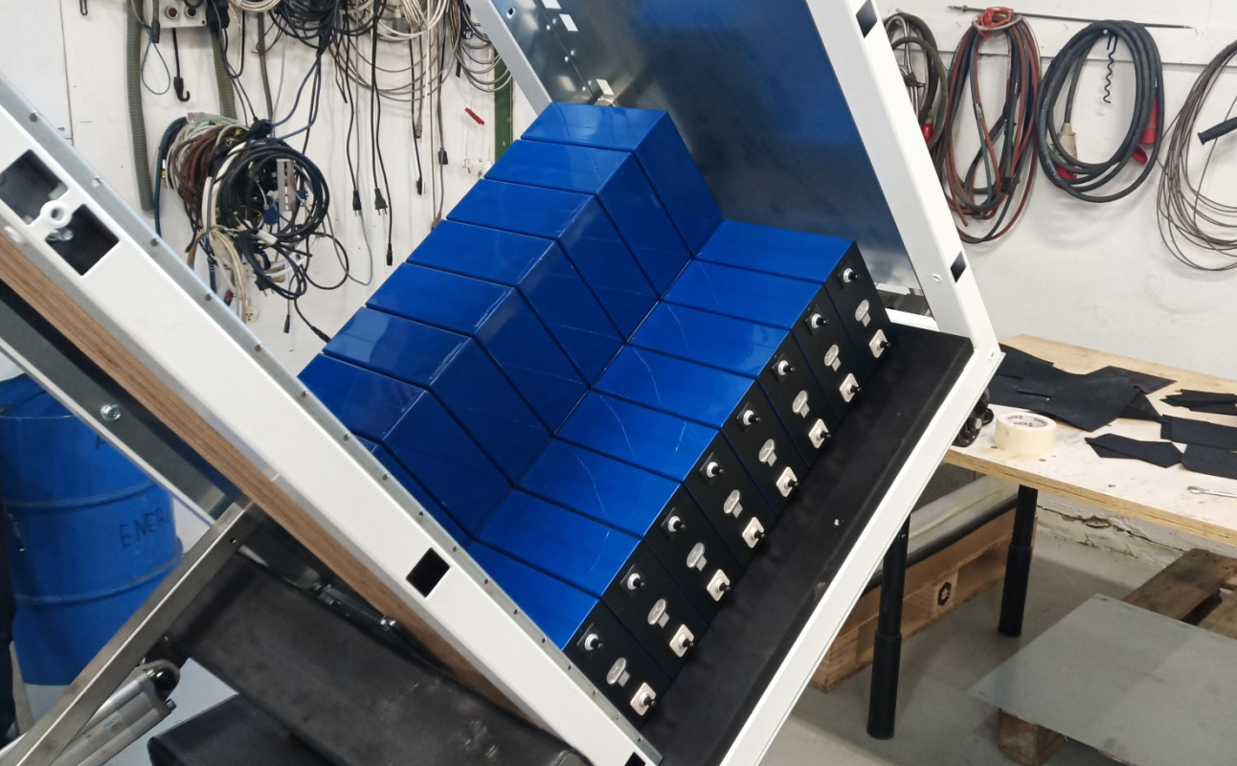
📍Country: Finland
🔋The cells battery from Gobel Power

Slide 13
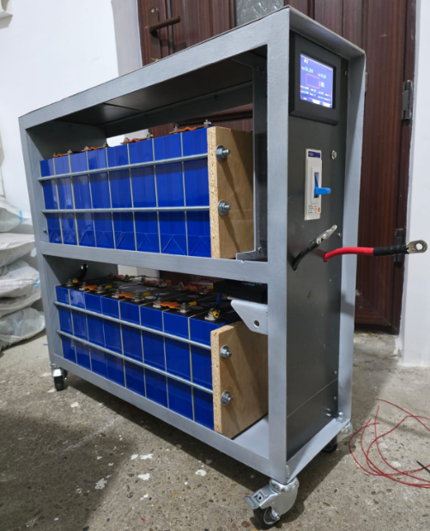
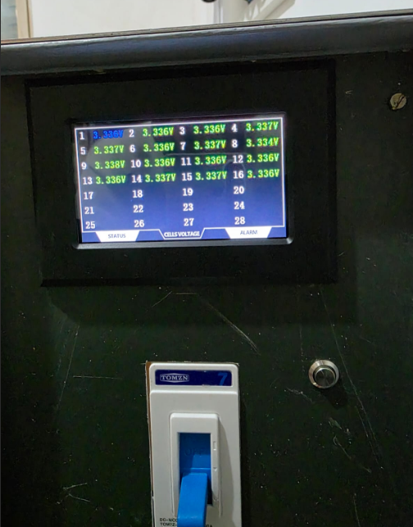
📍Country: Romania
🔋The EVE 314ah cells battery from Gobel Power

Slide 14
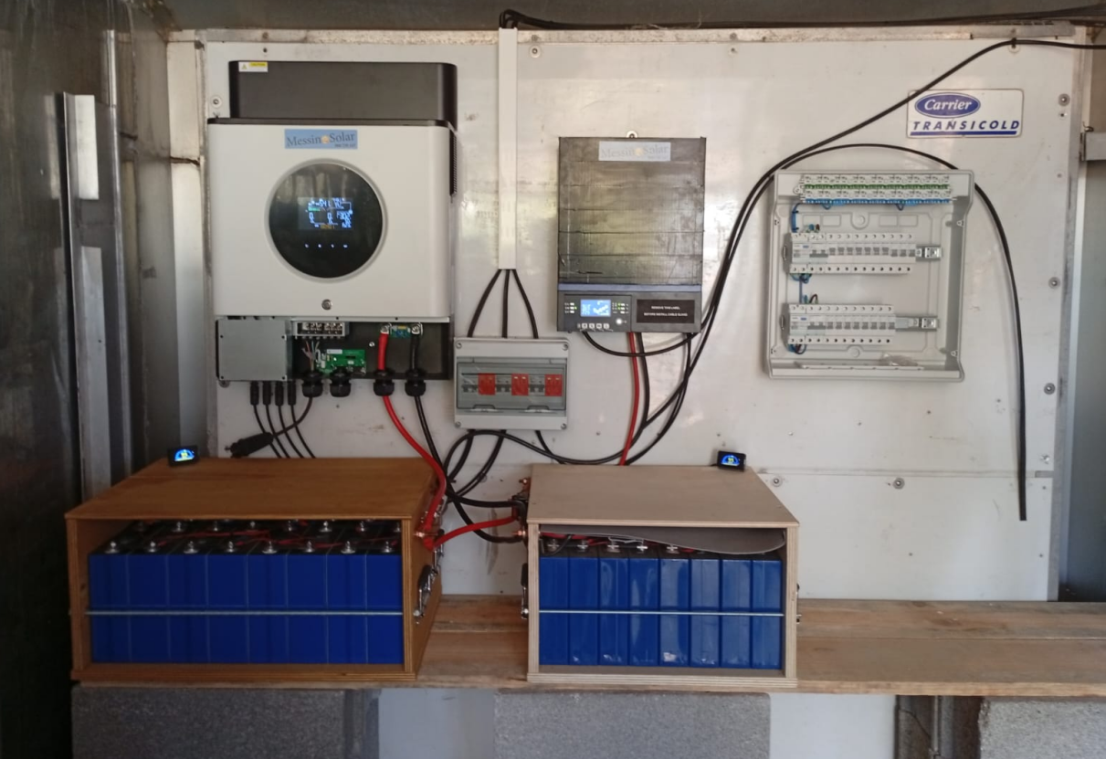
🔋 Portugal Customer :
EVE 314AH Cells supplied by Gobel Power

Slide 15
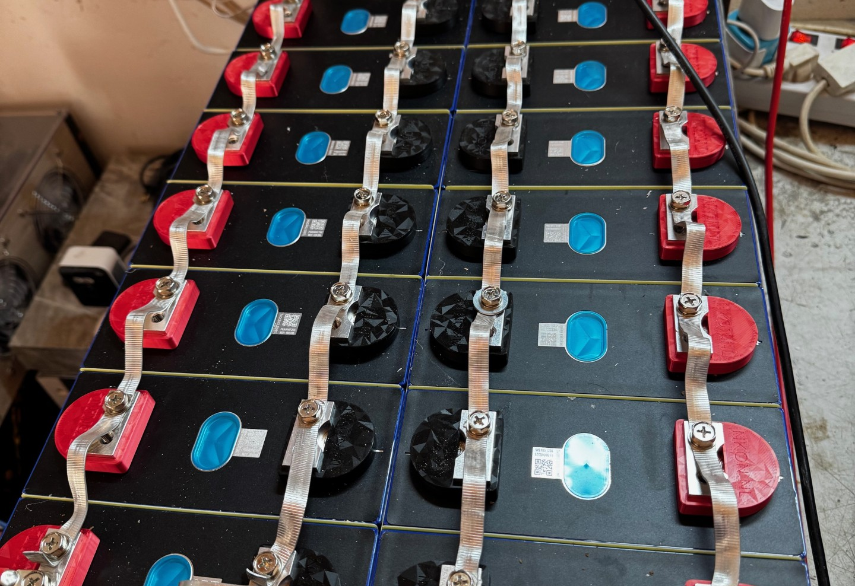
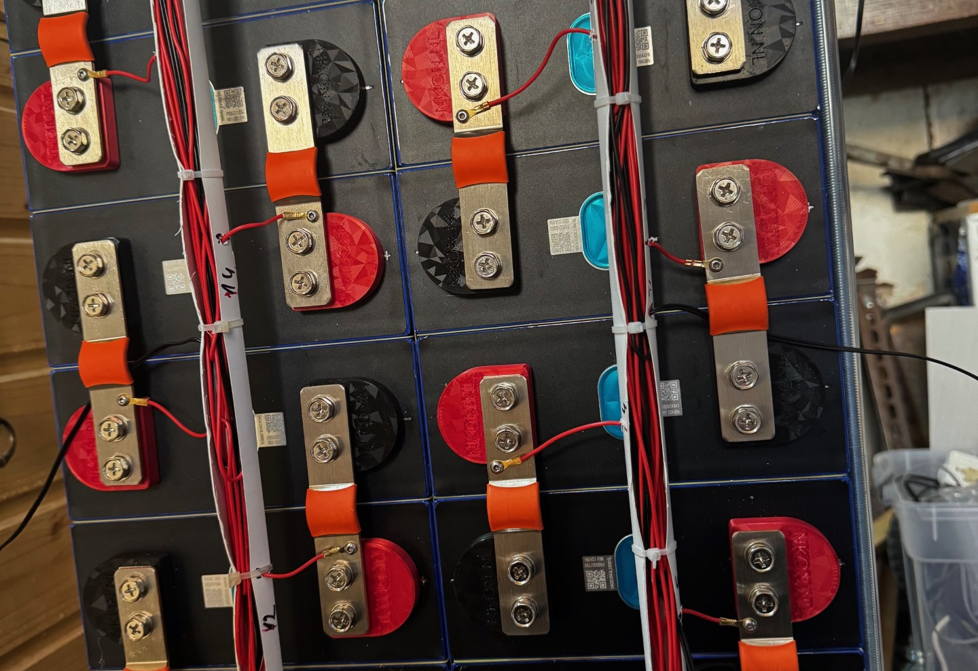
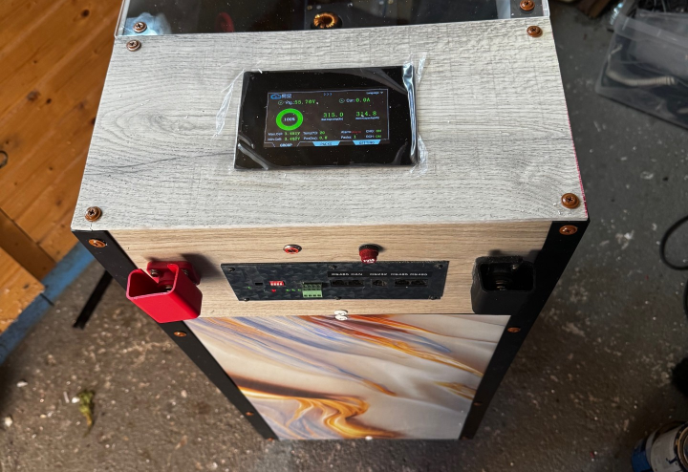
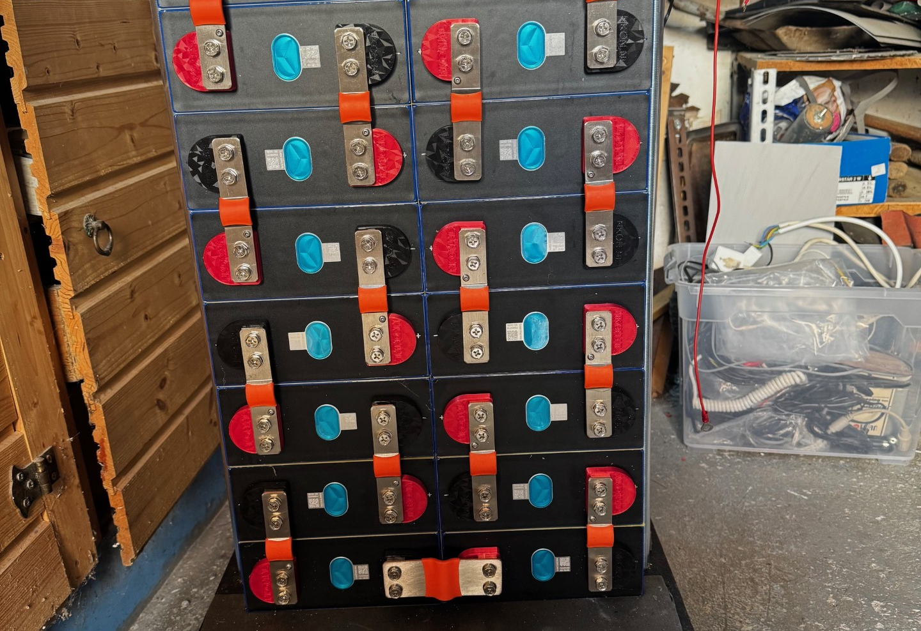
🔋 Romania Customer :
The cells battery from Gobel Power

Slide 16
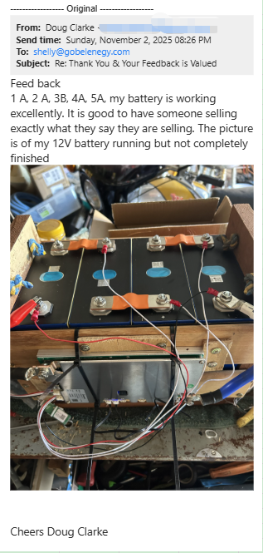
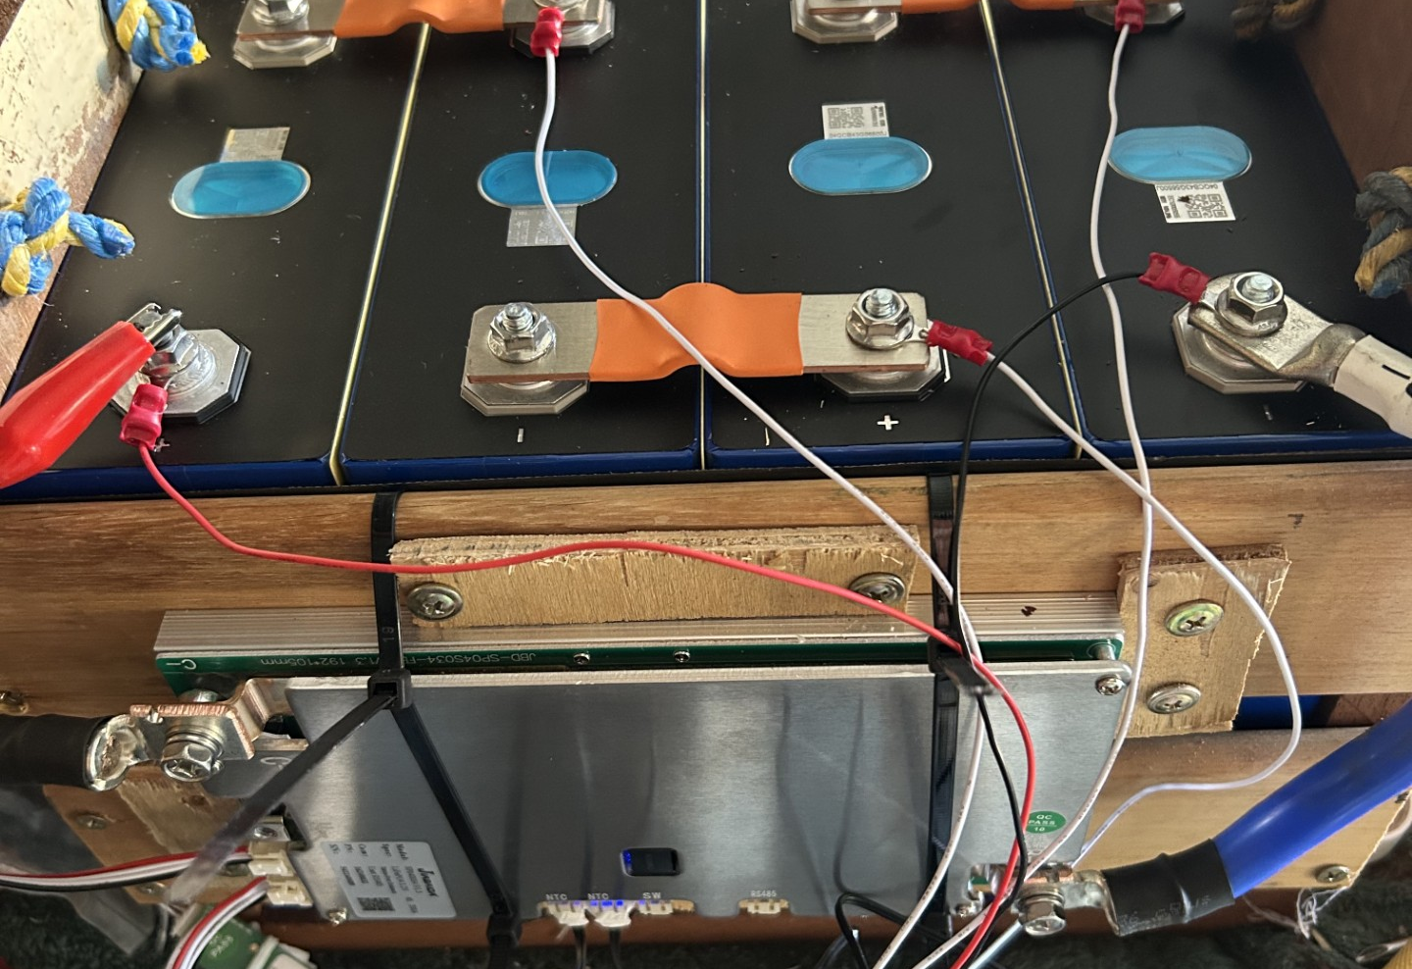
🔋 Australia Customer :
The Cells supplied by Gobel Power

Slide 17
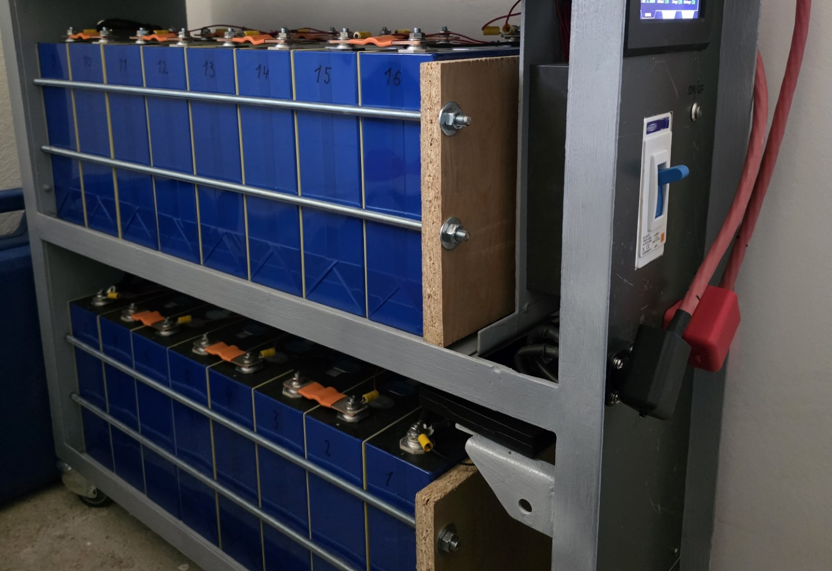
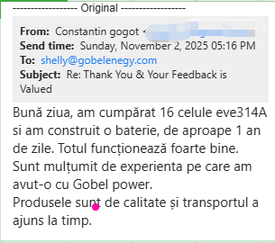
🔋 Romania Customer :
The cells battery from Gobel Power

Slide 18
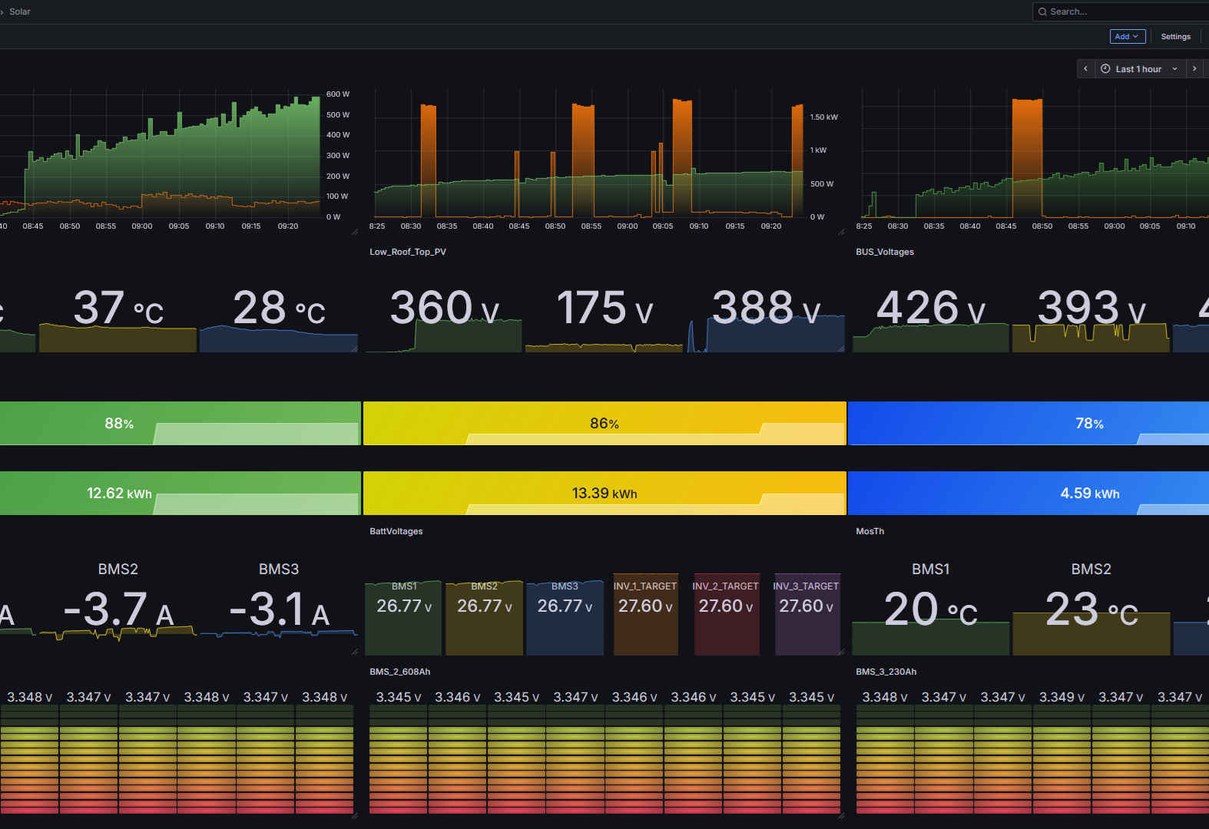
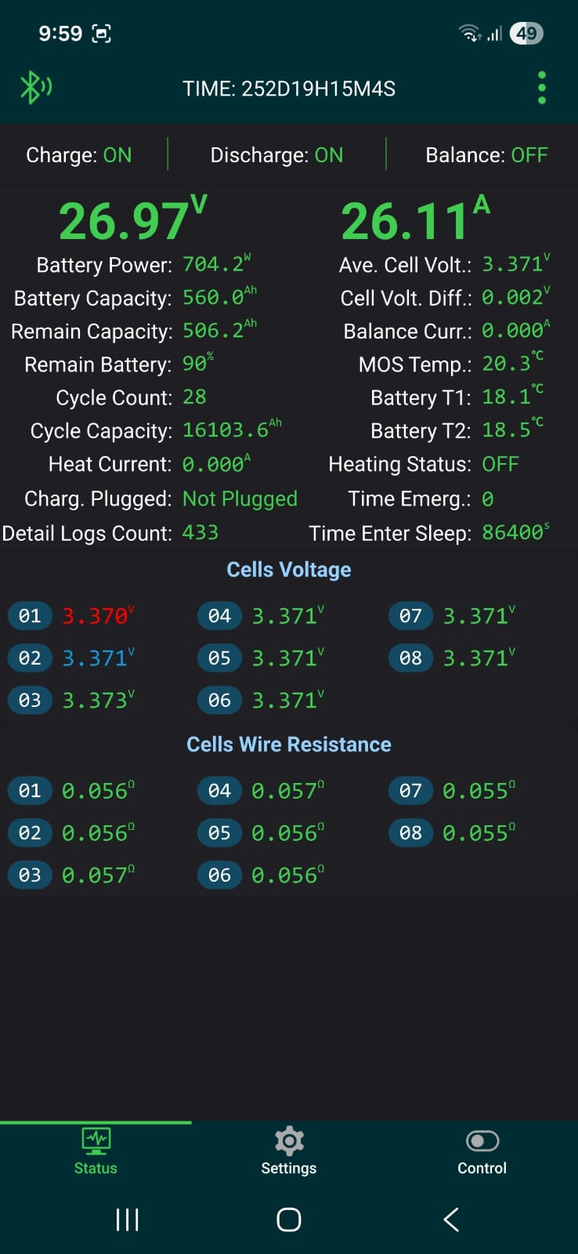
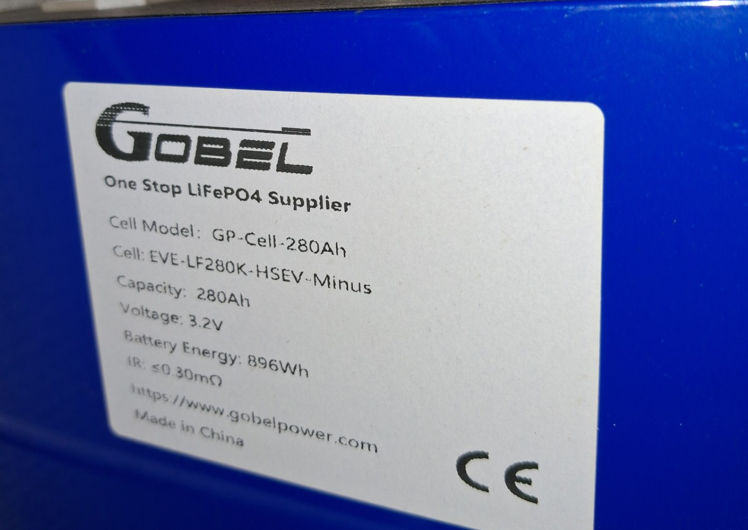
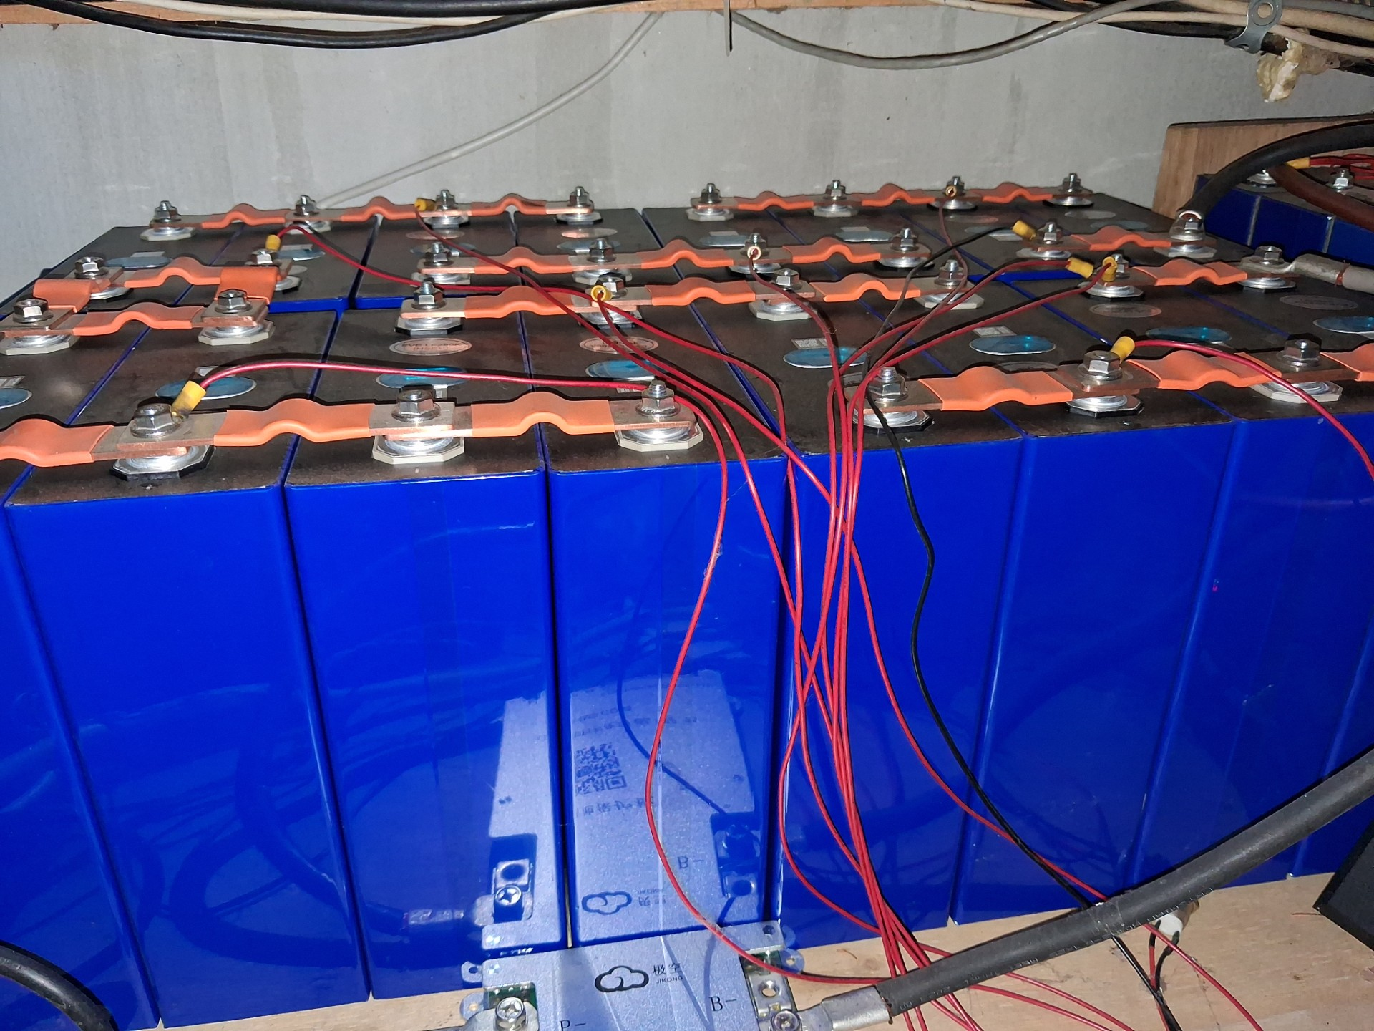
🔋 Romania Customer :
EVE 280AH Cells supplied by Gobel Power

Slide 19
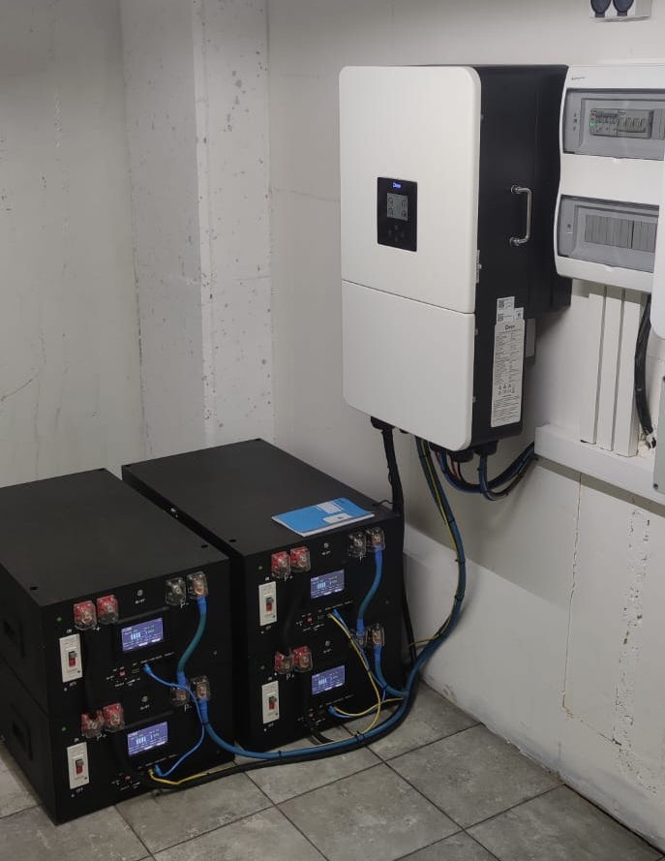
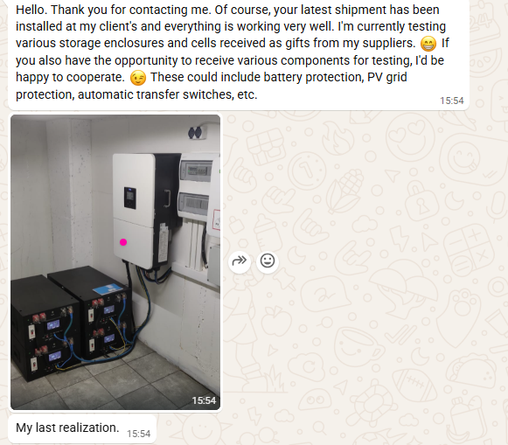
📍Country: Finland
🔋The cells battery from Gobel Power

Slide 20
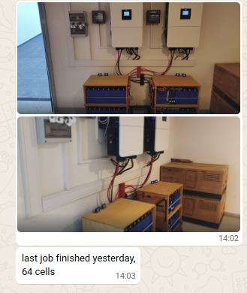
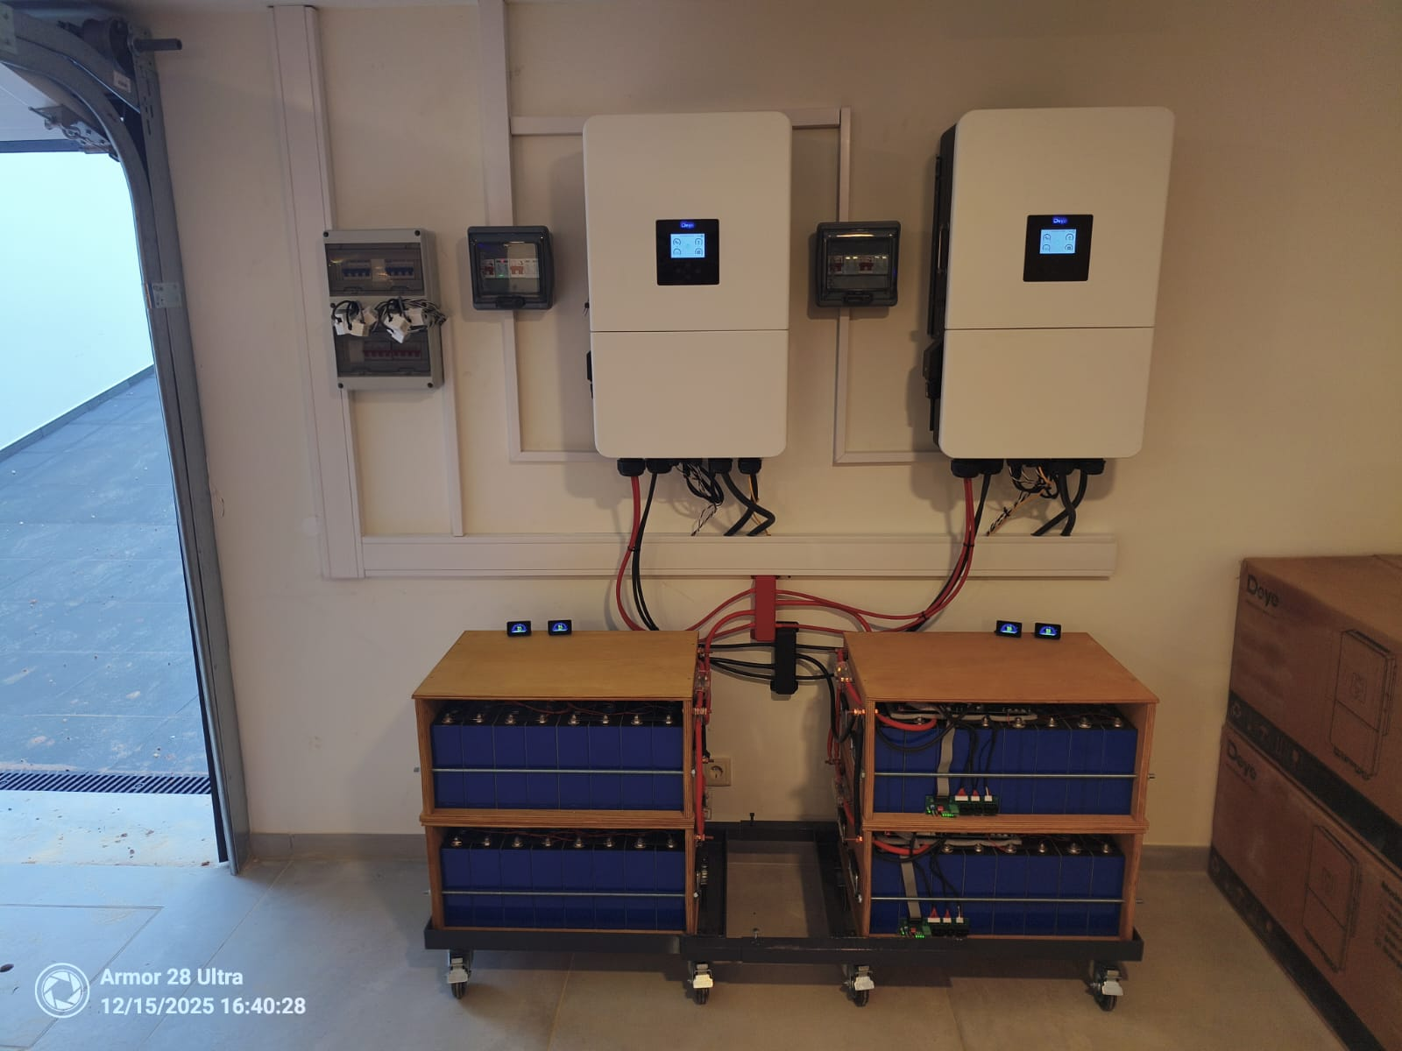
📍Country: Portugal
🔋The cells battery from Gobel Power

Slide 21
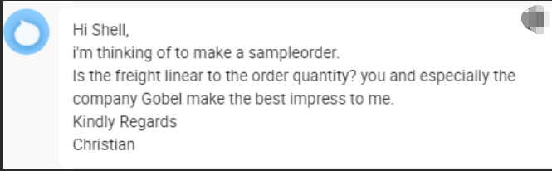
✨ German customer Feedback:
You and especially thecompany Gobel make the best
impress to me.

Slide 22
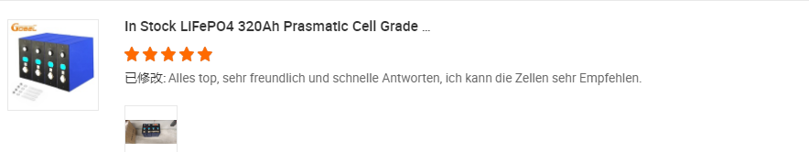
✨ German customer Feedback:
Everything is excellent, and I highly recommend these batteries.

Slide 23
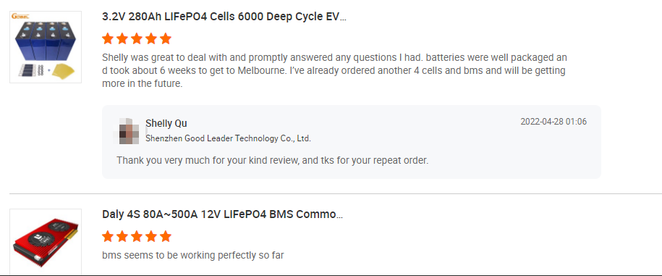
and took about 6 weeks to get to Melbourne
✨ Australia customer Feedback:
Batteries were well packaged and took about 6 weeks to
get to Melbourne.

Slide 24
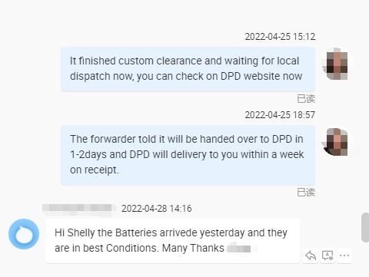
✨ German customer Feedback:
Batteries arrivede yesterday and theyare in best Conditions.

Slide 25
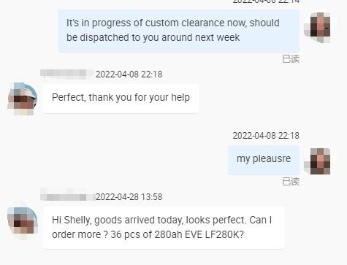
✨ German customer Feedback:
Goods arrived today, looks perfect. Can lorder more ?

Slide 26
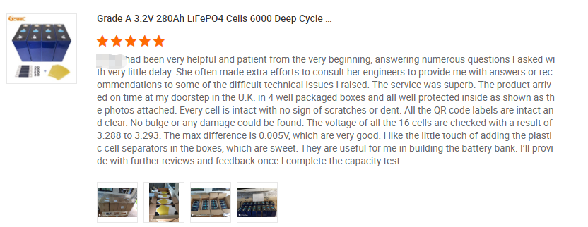
✨ German customer Feedback:
The voltage of all the 16 cells are checked with a result o3.288 to 3.293. The max difference is 0.005v, which are very good.

Slide 27
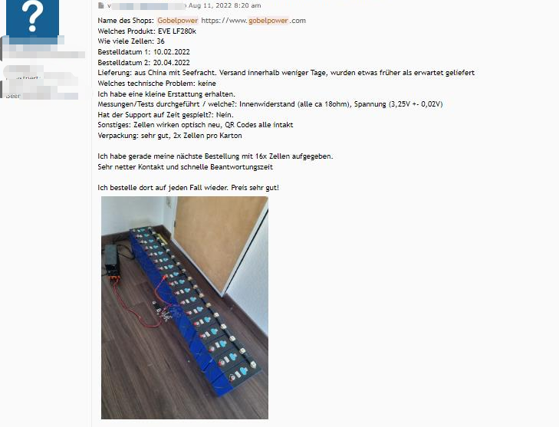
✨ German customer Feedback:
I'll definitely order from there again
—the prices are excellent.

Slide 28
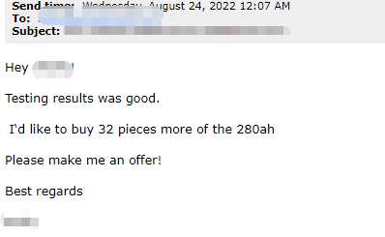
✨ German customer Feedback:
Testing results was good!

Slide 29
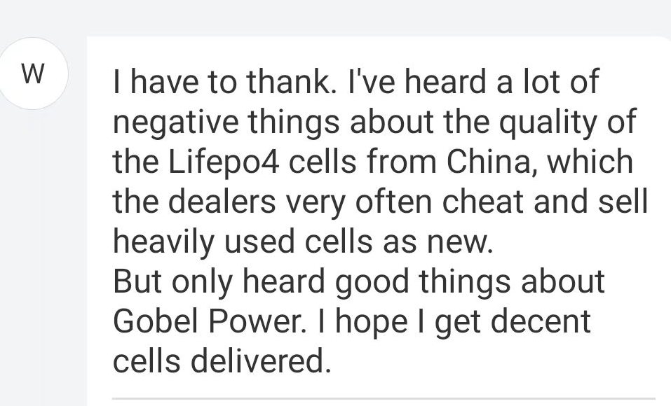
✨ German customer Feedback:
But only heard good things aboutGobel Power

Slide 30
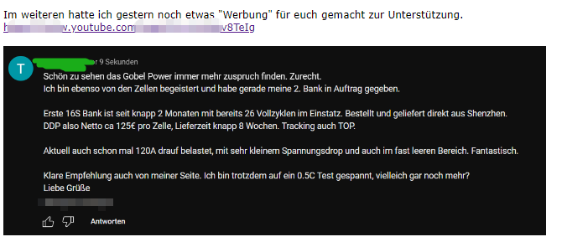
✨ German customer Feedback:
I'm also making videos on YouTube to promote Gobel Power.

Slide 31
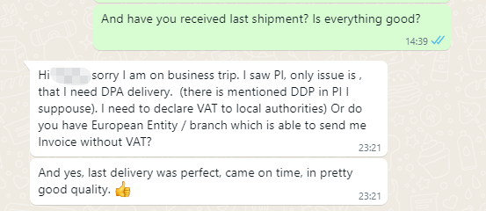
✨ German customer Feedback:
And yes, last delivery was perfect, came on time, in pretty
good quality.

Slide 32
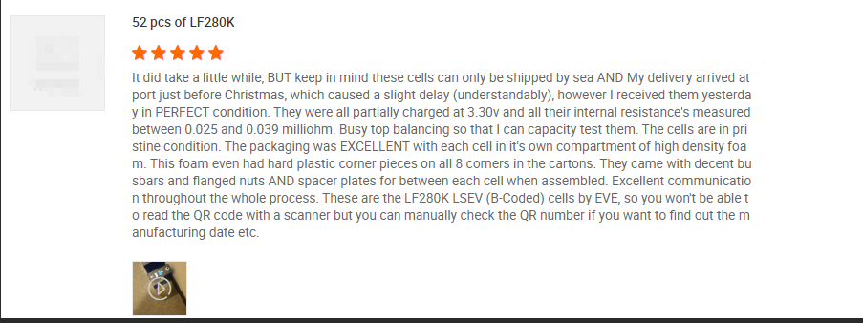
✨ South Africa customer Feedback:
The cells are in pristine condition. The packaging
was EXCELLENT with each cell in .

Slide 33
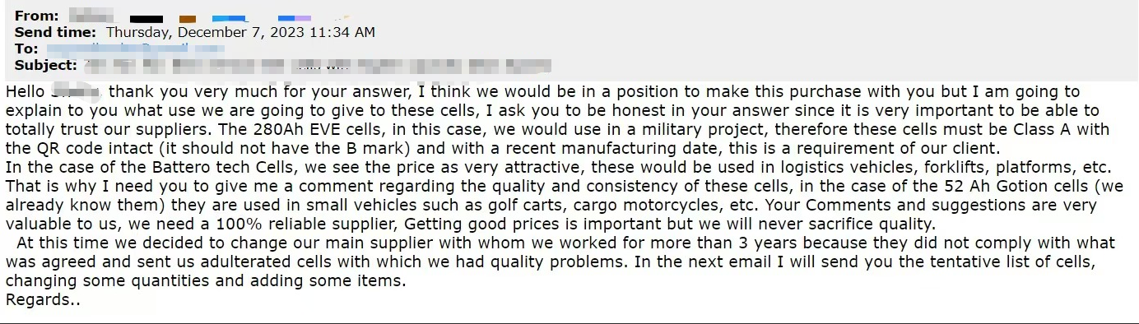
✨ Argentina customer Feedback:
I think we would be in a position to make this purchase
with you .

Slide 34

✨ Hungary customer Feedback:
So all in all l am very happy with
the deal and will return for more.

Slide 35

✨ Austria customer Feedback:
Compared to other merchants, Super Good.

Slide 36

✨ Netherlands customer Feedback:
Yes all looks good, thank you !

Slide 37

✨ Customer Feedback:
Give you a good review as
supplier who is honest and
hasintegrity and trustworthy

Slide 38

✨ Customer Feedback:
Full score for product, service, and quality.

Slide 39


✨ Spain customer Feedback:
Full score for product, service, and quality.

Slide 40

✨ Finland Customer Feedback:
Everything looks good;
very happy with the service.

Slide 41

✨ Philippines Customer Feedback:
Full score for product,
service, and quality.

Slide 42

✨ Canada Customer Feedback:
Full score for product,
service, and quality.

